Slide 1
BLASST NATIONAL LEADERSHIP SUMMIT
10th April, 2015
RECOGNISING AND REWARDING GOOD LEARNING AND TEACHING PRACTICE WITH SESSIONAL STAFF
#BLASST2015

Slide 2
Welcome to Country
Uncle Lex Dadd
Darug elder and traditional custodian
Elder in Residence, Macquarie University

Slide 3
Welcome to the summit
I would like to acknowledge the traditional owners – the Dharug people – and pay my respect to Elders past and present.
Support for this summit has been provided by the Australian Government Office for Learning and Teaching. The views expressed in this activity do not necessarily reflect the views of the Australian Government Office for Learning and Teaching.

Slide 4
The role of the BLASST Framework for systematising and rewarding good practice
Marina Harvey , Macquarie University

Slide 5
Sess·ion·al Staff /sessional stǽf/ noun. Any teachers in higher education employed on a casual, short-term contract, or sessional basis. This may include lecturers, tutors, unit, program and subject convenors, demonstrators, and markers (BLASST.edu.au)
The majority of teaching in Australian universities is now provided by sessional staff (May et al. 2013)
Relying on FTE calculations, sessional staff have grown by 81%
(Larkins, 2011)

Slide 6
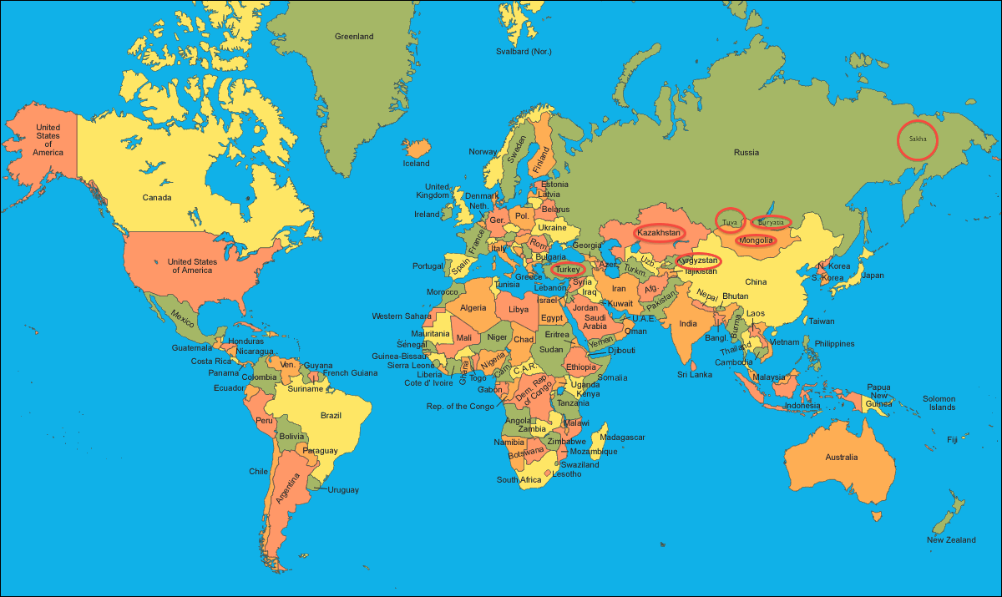
A global trend
Numbers are increasing in New Zealand (Gilbert, 2013).
“Atypical contracts” are growing across the United Kingdom (Bryson, 2013).
Increased reliance also found for the United States (Dolinsky, 2013) Canada, France, Germany and Japan (Bryson, 2013).

Slide 7
And the prediction is...
...that this reliance will continue
and even increase
(Jaschik & Lederman, 2015).
The majority (56 percent) of Chief Academic Officers across American institutions “agree or strongly agree that future generations of faculty in the United States should not expect tenure to be a factor in their employment at higher education institutions. Just 6 percent strongly disagree with this statement” (p.11).

Slide 8
One implication
The “significant reliance on academic staff employed under casual work contracts” (2012, p. 25) has been identified as a risk to students by the Tertiary Education Quality Standard Agency (TEQSA).

Slide 9
How well do you know your sessional staff?

Slide 10
We think we know sessional staff...
Majority of BLASST fora participants perceive themselves as having a high awareness of sessional staff issues
Low (N=54) High
When quizzed about sessional staff in Australian higher education (on a 9 item quiz, n=97) these participants achieved an average score of 27%

Slide 11
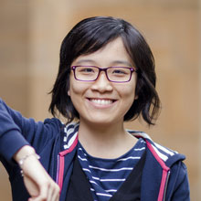
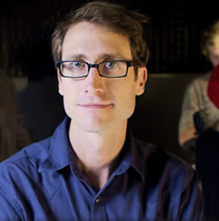
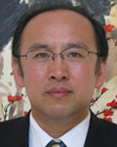
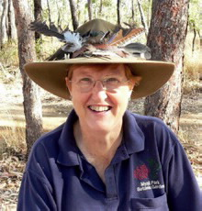
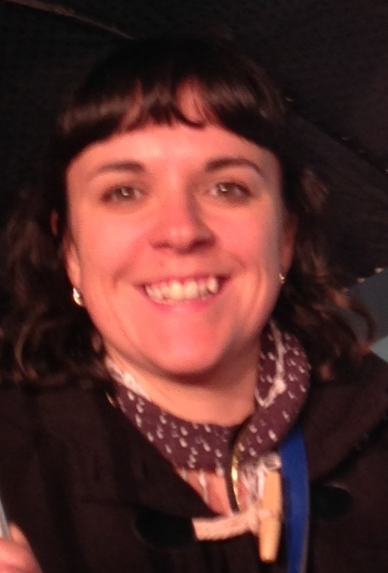
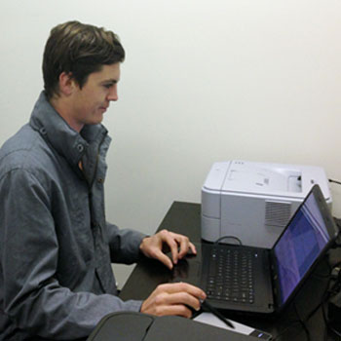
Can you pick the sessional staff?
1 2 3
4 5 6
http://futurestudents.unimelb.edu.au/info/international/in-australia / http://www.uow.edu.au/future/index.html
http://sydney.edu.au/china_studies_centre/en/business-forum/2013-speakers-panel-1.shtml
http://www.jcu.edu.au/mtb/staff/adjunct/JCUDEV_014141.html / http://www.whitlam.org/news_and_events/triple_j_40_years_broadcasting_for_the_young_men_and_women_of_australia
http://www.kipmcgrath.com.au/Australia/Karratha.aspx?contextid=634484888381112500

Slide 12
The BLASST.edu.au national standards framework is framed by three principles:
1. Quality Learning and Teaching
2. Support for Sessional Staff
3. Sustainability

Slide 13
The BLASST approach is underpinned by three key conceptual theories:
1. Reflective practice
2. Distributed leadership
3. Participatory Action Research

Slide 14
Piloting has demonstrated that the BLASST Framework...
recognises and incorporates the contribution of sessional staff,
is useful in a range of contexts and levels,
provides opportunities for review, reflection, (self-) evaluation as well as conversations and network building, and
demonstrates the practical value of these national standards for sessional staff.
Luzia, K., Harvey, M., Parker, N., McCormack, C., Brown, N., & McKenzie, J. (2013). Benchmarking with the BLASST Sessional Staff Standards Framework. Journal of University Teaching and Learning Practice, 10(3). http://ro.uow.edu.au/jutlp/vol10/iss3/5

Slide 15
BLASST has a proven role in:
Systematising good practice
through its educative & benchmarking functions
Rewarding good practice
through internal & external recognition/awards
Leading good practice
nationally & increasingly internationally

Slide 17
National Keynote
The Organisational level
A holistic, institution-wide approach to building and supporting sessional staff capacity
Professor Jillian Hamilton
Associate Director, Learning and Teaching Development
Queensland University of Technology (QUT)

Slide 18
National Keynote
The Disciplinary level
Smart Casual 2
Dr Natalie Skead
Acting Deputy Dean and Senior Lecturer
Faculty of Law
University of Western Australia
&
Professor Alex Steele
Associate Dean (Academic)
Faculty of Law
UNSW

Slide 19
National Keynote
The Individual level
The lived experience of women casual academics, what we can learn from those that teach at university
Gail Crimmins
Associate Lecturer, Communication
University of the Sunshine Coast

Slide 20
The collective level
Social Media as a new CoP for sessional staff
Panel presentation
Dr Kate Bowles
CASA & University of Wollongong
Dr Katie Freund
ANU
Dr Jen Tsen Kwok
Uni casual (via Skype)
#AdjunctChat
adjunct.chronicle.com

Slide 21
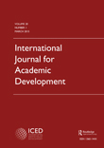
International Journal for Academic Development
CALL FOR PAPERS | Special Issue (2017)
Quality learning and teaching with sessional/adjunct/casual teachers:
Systematising good practice for
academic development
Dr Kathryn Sutherland,
Co-Editor

Slide 22
Good learning and teaching practice with sessional staff
Q & A Panel
Dr Beth Beckmann
OLT National Teaching Fellow, ANU
Dr Karen Treloar
Director Regulation and Review, TEQSA
Trish Treagus
Director for Awards and Networks, OLT
Carolyn Barker, AM
CEO, Endeavour Learning Group
Sarah Yu,
Sessional Staff respondent, University of Canberra

Slide 23
BLASST National Good Practice Awards
Presentation of finalists

Slide 24
Thank you
http://www.yourextrahand.com/bookkeeping-evaluation/

Slide 25
For more information about Australian Learning and Teaching Fellows please visit visit www.altf.org
Dr Marina Harvey
2014 OLT National Teaching Fellow
Macquarie University
marina.harvey@mq.edu.au
blasstspeak@gmail.com
blasst.edu.au
Support for this Fellowship has been provided by the Australian Government’s Office for Learning and Teaching. The views expressed in this publication do not necessarily reflect the views of the Australian Government Office for Learning and Teaching.

