Slide 1
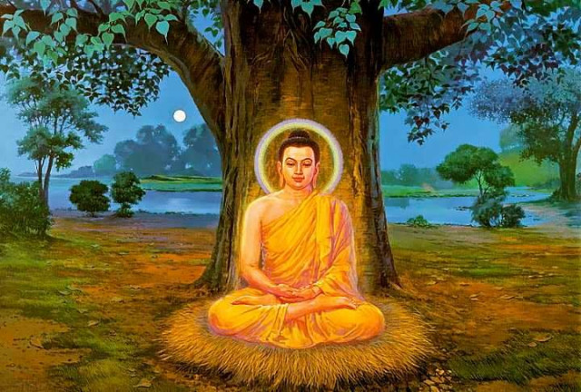
The philosophical basis of Mindfulness: a potted history
Philosophy convocation June 2022 Leesa S Davis

Slide 2
What is mindfulness?
Mindfulness encourages paying attention to what is happening during each moment of your life. With mindfulness, we develop the ability to let go of worries and fears about the future, let go of concerns about the past, and experience the present moment with a sense of calm and curiosity. In a basic way, mindfulness gives us the ability to wake up to our life and stop the automatic way of living, which disconnects us from our body, mind, and relationships.
Mindfulness Center, University of Utah

Slide 4
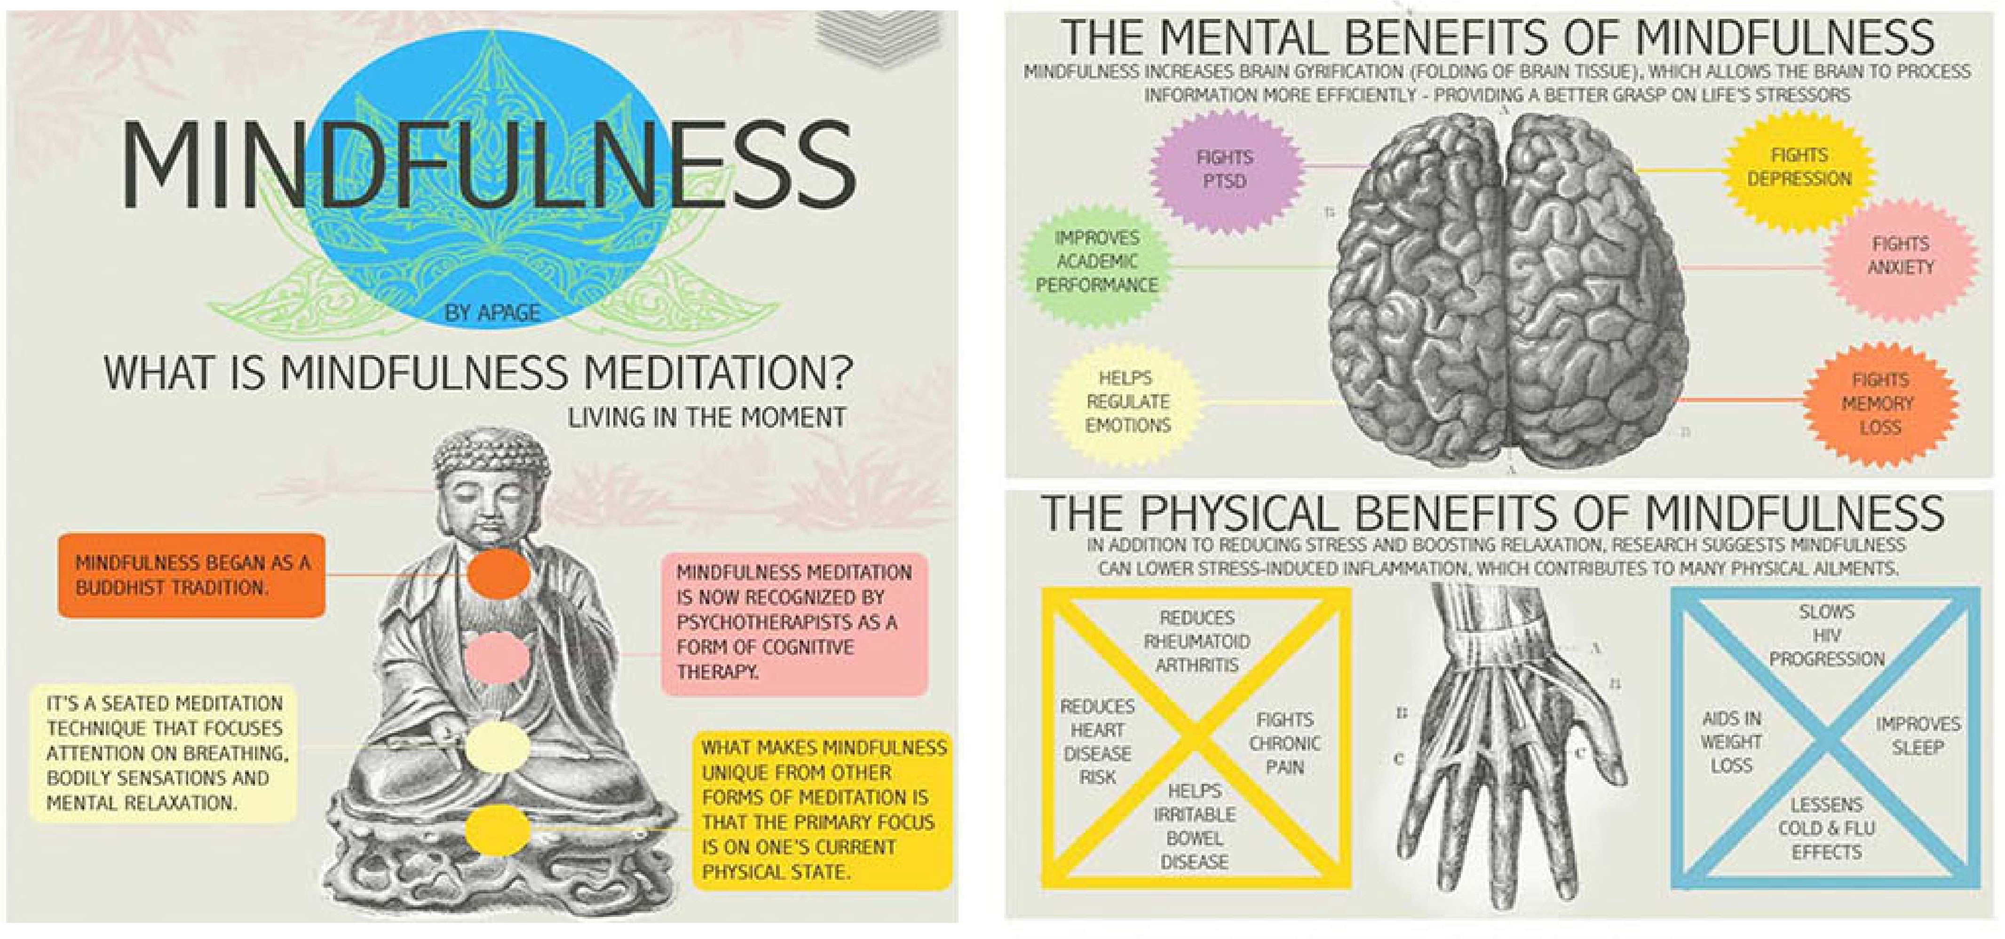

Slide 5
Things as they are
According to Buddhism, realizing “things as they are” or “life as it is” involves understanding the three fundamental characteristics of existence, that is phenomena and “selves” are:
Impermanent dynamic processes
they have no “fixed” or substantial essence - they are always in flux
They are radically interdependent

Slide 6
Basic Buddhist Philosophy
Impermanence: all things are impermanent and subject to change
No-self: no fixed essence or substantial qualities –more like a process idea of self.
Interdependence (dependent co-origination): sometimes called the “great chain of being” -a stream of creative processes in which nothing persists or endures but is radically inter-dependent

Slide 7
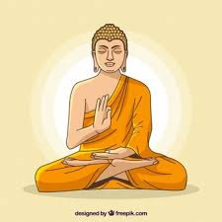
What has this to do with meditation?
According to Ven. S Dhammika:
Meditation is a conscious effort to change how the mind works. The Pali word for meditation is 'bhavana' which means 'to make grow' or 'to develop'.
Meditation helps to develop the awareness and the energy needed to transform ingrained mental habit patterns.
Ultimately, meditation is the ground from which we cultivate the qualities of perception and awareness to “see things as they are”.

Slide 8
Four truths/realities
Suffering (dukkha)
Origin of suffering (dukkha-samudaya)
Cessation of suffering (dukkha-nirodha)
The path leading to the cessation of suffering (dukkha-nirodha-gāminī paṭipadā)

Slide 9
What is the connection between the 4NT’s and mindfulness?
Part of the 4th noble truth: one of elements of the eightfold path sammasati/right mindfulness.
Distinguished from two other elements in meditation (right effort and right concentration).
Right mindfulness is, set between right effort and right concentration, it connects the energetic application of the mind to its stilling and application."

Slide 10
The Three Marks of Existence
The three marks of existence are:
1. Anicca(Pali)/anitya (Sanskrit) – impermanence.
2. Dukkha (Pali)/Duhkha (Sanskrit) – suffering, unsatisfactoriness, stress, pain.
3. Anatta (Pali)/Anatman (Sanskrit) – selflessness, no-self.
The Buddha’s claim is: everything that exists necessarily has these attributes. Therefore, there is no other way for a thing to exist.

Slide 11
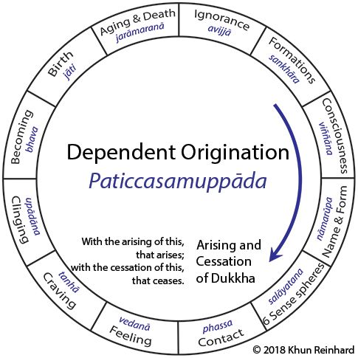
Dependent co-origination & the twelve links
The principle of causality
These are the Buddhist account of the person’s journey through endless births/deaths/rebirths.
It is also the Buddhist account of selflessness: nowhere in twelve links is there being. Only processes which arise, abide and cease.
It is also the Buddhist account of dukkha: the fact of this being an endless, circular process which always gives rise to dukkha.
And of causation: each link in the chain depends on a prior cause.

Slide 12
Where the action is…..
It is here in this space between feeling and craving that the battle will be fought which will determine whether bondage will continue indefinitely into the future or whether it will be replaced by enlightenment and liberation. For if instead of yielding to craving, to the driving thirst for pleasure [or indulging in aversion], if a person contemplates with mindfulness and awareness the nature of feelings and understands these feelings as they are, then that person can prevent craving from crystallising and solidifying.
Bhikkhu Bodhi

Slide 13
The Five Aggregates (khandhas/skandhas)
1. Form (rupa).
2. Feeling (vedana).
3. Perception/discernment (sanna/samjna).
4. Mental events/volitions/dispositions (sankhara/samskara).
5. Consciousness (vinnana/vijnana).
Mindfulness of these implies gaining awareness (and subsequently, insight) into all the elements which make our subjective experience.
One will see three key things: 1. every thing that arises here is impermanent. Eg body, feelings. 2. it is all in the nature of dukkha (this is the third sense – all pervading dukkha). 3. there is no “Self” to be found over and above these processes.

Slide 14
What Does All Of This Tell Us About You?
1. As an existent thing, you are selfless, impermanent and in the nature of dukkha.
2. Your selflessness means: you are who you are in the light of causes and conditions; there is no ‘you’ over and above this.
3. Therefore, you are fundamentally an interdependent being –
4. But there may be a cognitive gap between this reality and how you take yourself to be.
5. This gap is ignorance, and because of it dukkha ensues (one grasps at sense objects, generates desires etc)
6. Wisdom = crossing that gap; realizing yourself to be selfless/dependent. In doing so, dukkha ceases.

Slide 15
The Buddha’s practice instructions: Satipatthana Sutta
This is the only way, monks, for the purification of beings, for the overcoming of sorrow and lamentation, for the destruction of suffering and grief, for reaching the right path, for the attainment of Nibbana, namely, the four foundations of mindfulness.

Slide 16
Defining Mindfulness (Sati/Smrti)
Sati (Pali) and Smrti (Sanskrit).
Linguistically seems to refer straightforwardly to “memory” or ‘remembrance” – but the early Buddhist usage of the term clearly offers a more nuanced and complex sense of it.
Also clearly implies a strong sense of ‘clear awareness’ and ‘coming to know’ of the given object of contemplation.
Also implies sustained concentration of the object of contemplation; mindfulness is part of that which enables that concentration to abide.
So, all of these senses are combined in the notion of sati/smrti: remembrance/recollection, awareness, clarity and concentration.
Entails understanding the two fundamental kinds of Buddhist meditation: insight and concentration (vipassana/vipashyana and samatha/shamatha).

Slide 17
The Four Foundations of Mindfulness (as found in the Satipatthana Sutta).
Mindfulness of body: mindfulness of body begins by generating awareness of breathing, then the postures and actions of the body (i.e. how you are using the body), then the repulsiveness of the body (i.e. blood, pus, urine etc), then reflection on the material elements, then 9 cemetery contemplations (i.e. the different ways one’s own body is similar to corpses at various stages of decomposition).
Mindfulness of feeling: Implies gaining awareness of pleasurable and painful feelings. In particular, to note their fleeting nature. Strongly connected with dukkha and impermanence. Also with selflessness/ non-self (anatta/anatman)
Mindfulness of consciousness/Mindfulness of mental events Mindfulness of mind or consciousness/mental events. Buddhists make a distinction between consciousness (vinnana/vijnana) and dispositions/traits/karmic volitions (sankharas/samskaras).with mindfulness of consciousness you are coming to know different conscious states, with mindfulness of mental events you are more passively ‘watching’ different kinds of mental states arise and cease. In cultivating awareness of mental phenomena – the practitioner passively registers the events of the mind without any commentary. All the thoughts, impressions, ideas and scenarios that come and go in the mind.

Slide 18
Mindfulness in Concentration and Insight Meditation
Shamatha/concentration is the meditation which develops sustained focus on a singular object.
Insight meditation is the meditation which develops analytical understanding into the nature of the reality, the self, dukkha, the four noble truths etc.
One needs to develop the former in order to make progress in the latter; the latter is what causes panna/prajna (wisdom) to arise.
mindfulness is necessary for both forms.
Concentration: the memory or recollection implies a mental function which can discern when focus on a singular object lapses, thus ‘bringing the mind back’ to the object. Without mindfulness, one would ‘forget’ the singular object of meditation and simply drift aimlessly into a myriad of other objects. So mindfulness in this sense is akin to ‘not forgetting the object of meditation.’ So here the sense of ‘remembrance’ is quite apt.
Insight: on the basis of concentration and mindfulness, bringing awareness into various elements of one’s subjective experience/reality. The Satipatthana Sutta contains a lot of depth on this front. So here, the sense of ‘clear and present awareness of the content of experience’ is quite apt.

