Slide 1


Welcome to: Inclusive curriculum in CloudFirst
Darci Taylor
Senior Lecturer, CloudFirst CoDesign Project
Dr Jo Elliott
Lecturer, Digital Innovation
Introduce yourself to those around you and talk about:
What has been your experience of online learning?
How (if at all) has it been inclusive?
Participate via Slido – https://www.sli.do/ enter #X033

Slide 2
Outline for today
What is CloudFirst?
CloudFirst Learning Design and Inclusive Education Principles (IEP)
Examples of IEP in CloudFirst
CloudFirst Resources
Discussion

Slide 3
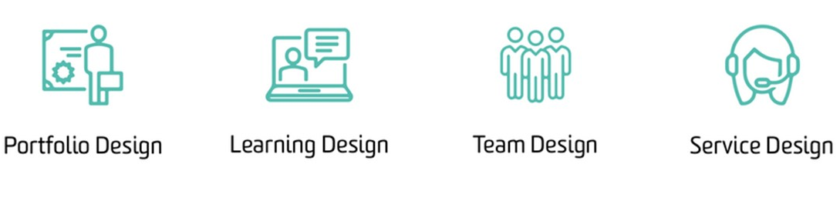
What is CloudFirst?
At Deakin, all students’ learning experiences begin online.
CloudFirst is an approach prioritising students’ online learning experience, complemented by onsite learning (where applicable).
The CloudFirst design:
Notes:
21C skills: creativity, critical thinking, communication and collaboration.
21C learning: social, collaborative, active, problem solving, multimedia

Slide 4
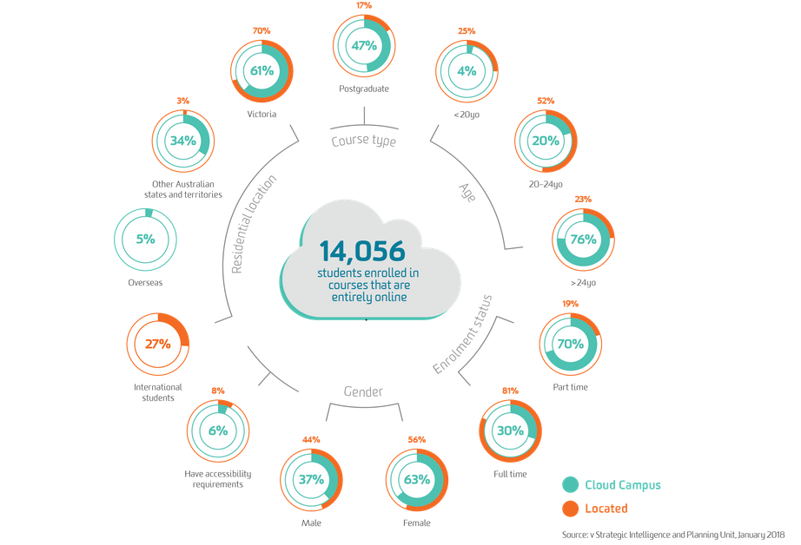

Why CloudFirst?
LIVE The Future Agenda 2020: ‘Offer a brilliant education’
Exemplar in online education
Online students have unique challenges: alone, disconnection, lost, relevance, lower retention
Source: Deakin University (n.d.); SIPU (n.d.), Brunton et al. (2016)

Slide 5

CloudFirst as a CoDesign Process
PPLT 10
Students
Project Management
Judy Currey (Active Learning), Steve Brown
External Suppliers
(Post-production etc.)
Digital Resource Developers
Fabrice Bernard,
Philip Burke, Jason White, Filip Laureys
CloudCampus
Lucy Schulz, Dan Steen,
Lea Piskiewicz
Academic staff
Darci Taylor, Jo Elliott
Other stakeholders
Faculty/School leads, unit leads, library, digital accessibility, Inclusive education
Senior Educational Designers
Jon Gould, Rene Hahn, Chris Rawson, Erik Beyersdorf, Danni McCarthy
Mary Dracup
Karen Brassington, Francois Jacob, Laszlo Romer

Slide 6
Students in CloudFirst CoDesign Units
MBA
8 units
LLB
8 units
M Education
7 units
3 pre-term units

Slide 7
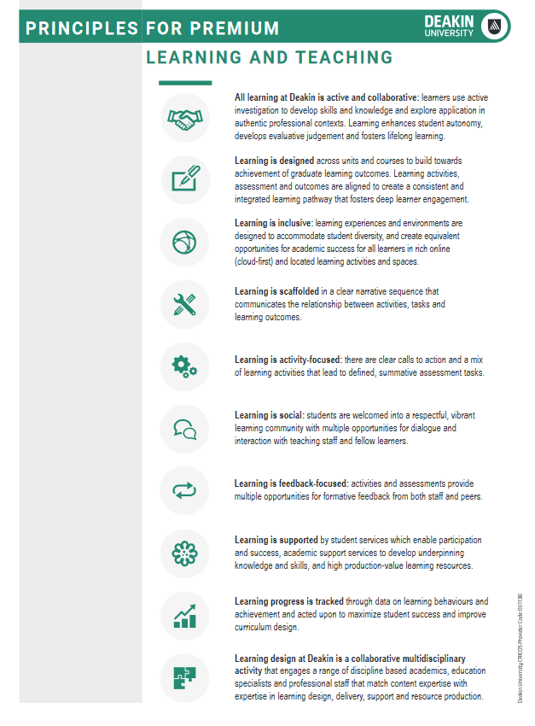
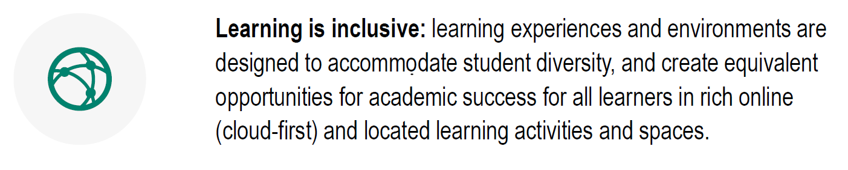

Deakin Curriculum Framework – PPL&T
Source: Deakin University (2019a)
Notes:
Part of the Deakin Curriculum Framework under -experience

Slide 8
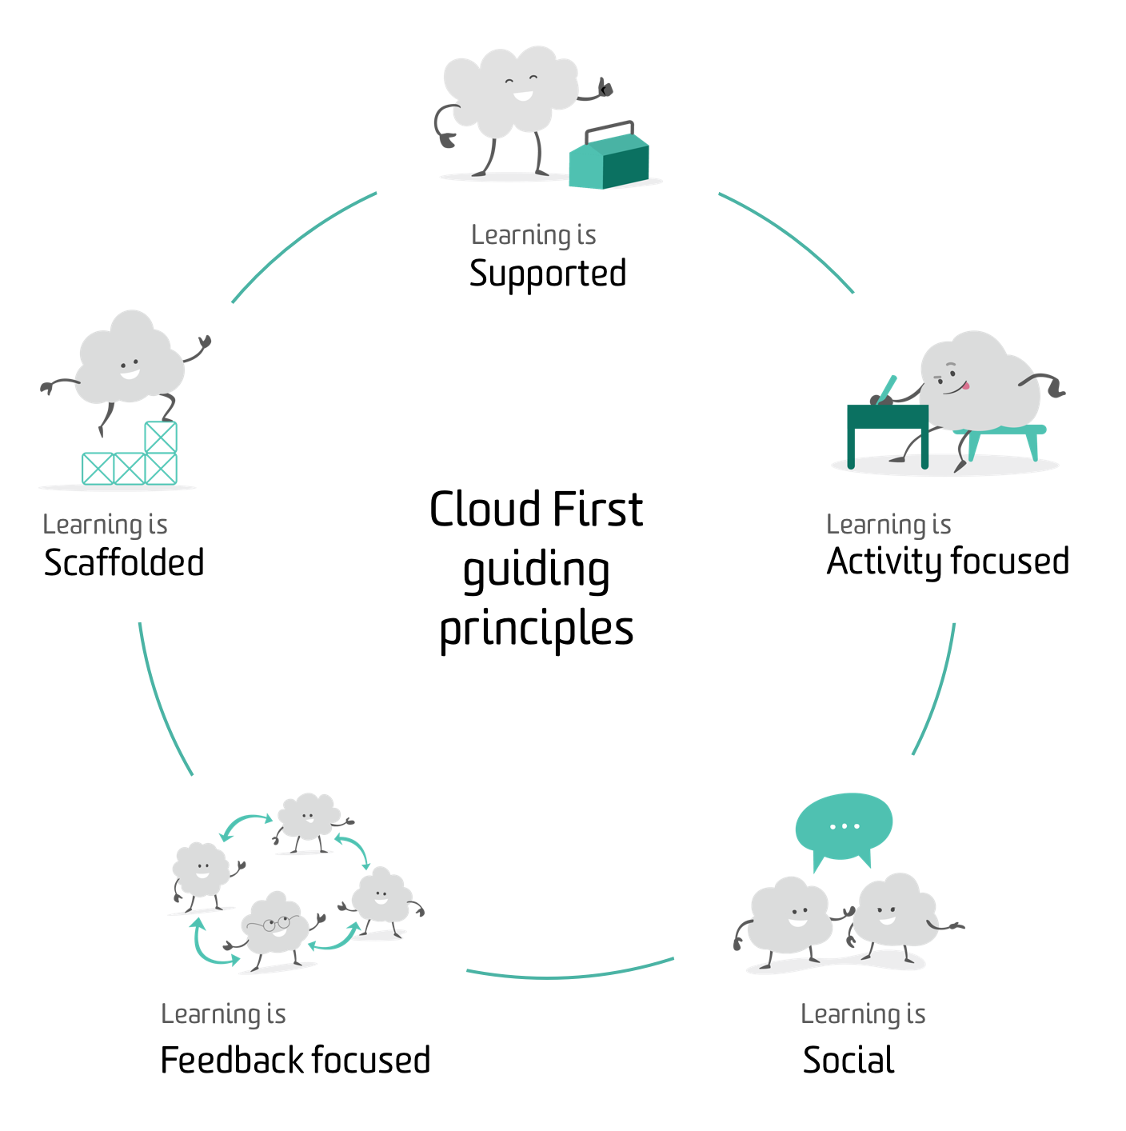
CloudFirst Learning Design
Application of Principles for Premium Learning and Teaching (PPLT) with a CloudFirst lens
Models premium cloud teaching and learning (set the direction for continuous uplift of T&L with a focus on the cloud)
Contextualised for discipline and learning context
PPLT 3|8
CloudFirst Learning Design
PPLT 2|4
A collaborative & multidisciplinary activity
PPLT 10
PPLT 1|5
PPLT 1|6|9
PPLT 1|3|7
Notes:
In practice, the PPLT can be readily clustered together to aid in the design and development of online learning experiences. To enable teaching teams to operationalise these clusters according to discipline and educational contexts, the requirements at the unit level are outlined for each cluster.

Slide 9
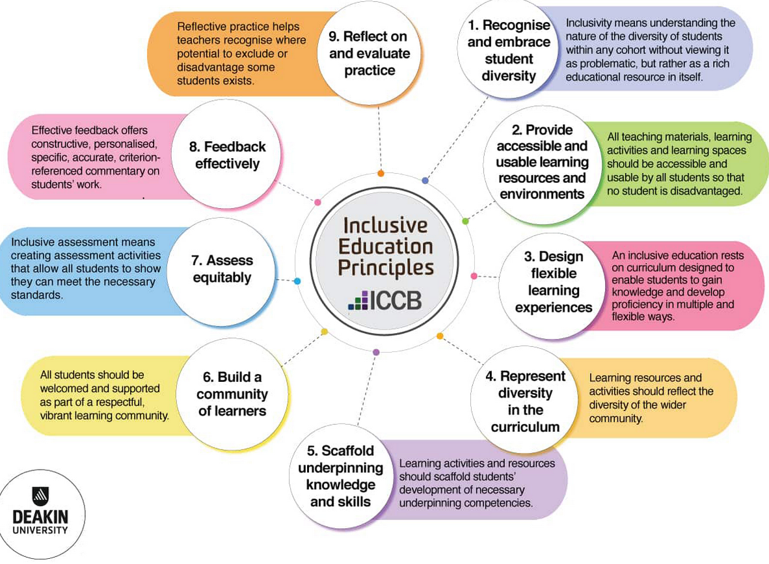

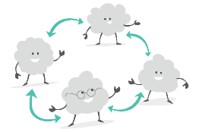



CloudFirst Learning Design & IEP
Source: Deakin University (2019b)
Notes:
We actually do all of these across the clusters –they are embedded in what we do.

Slide 10

Learning is supported PPLT 3|8
By student services which enable participation and success, academic support services to develop underpinning knowledge and skills, and high production-value learning resources.
Support includes creating inclusive experiences and environments that are designed to accommodate student diversity, and create equivalent opportunities for academic success for all learners in rich online and onsite learning activities and spaces.
Notes:
This slide includes an image of a cartoon cloud character with a toolbox.

Slide 11
Learning is supported continued PPLT 3|8
Each unit:
has opportunities for multiple modes of engagement
learning resources and activities embrace diversity as an educational resource in itself
uses heading hierarchies and a consistent design ethos (layout, icons, navigation, colour palette, typography)
maintains a high standard of multimedia and learning resources
applies WCAG2.1 digital accessibility standards
provides clearly signposted and easily accessible links to study support services (e.g. Library, Academic and Peer Support, Mentoring & Counselling services)
Notes:
This slide includes an image of a cartoon cloud character with a toolbox.

Slide 12
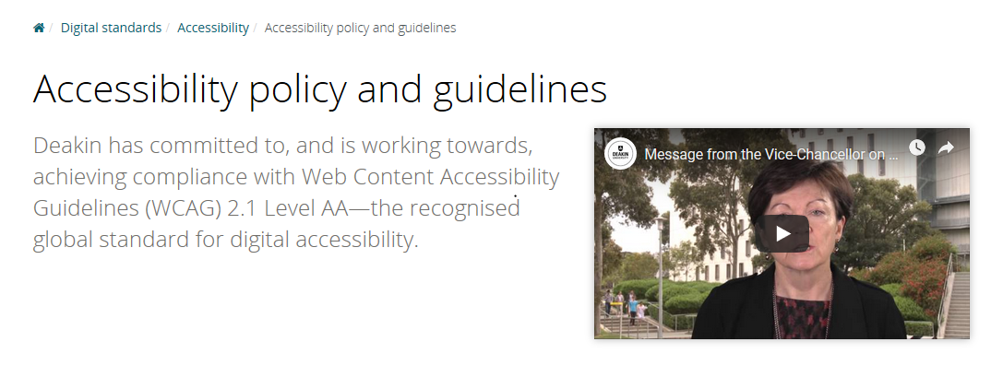
Digital accessibility targets
Source: Deakin University (2019c)
Notes:
So a big part of this is trying to model good practice WCAG2.1 as our focus is primarily on the Cloud site, then the f2f component

Slide 13
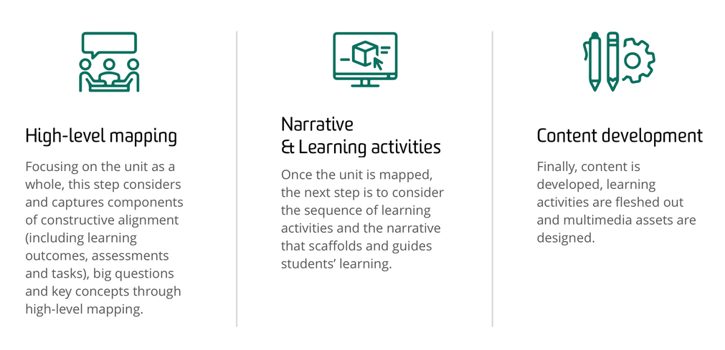
The design process
Notes:
We have embedded in all our learning design templates elements that assist with designing for inclusivity.

Slide 14
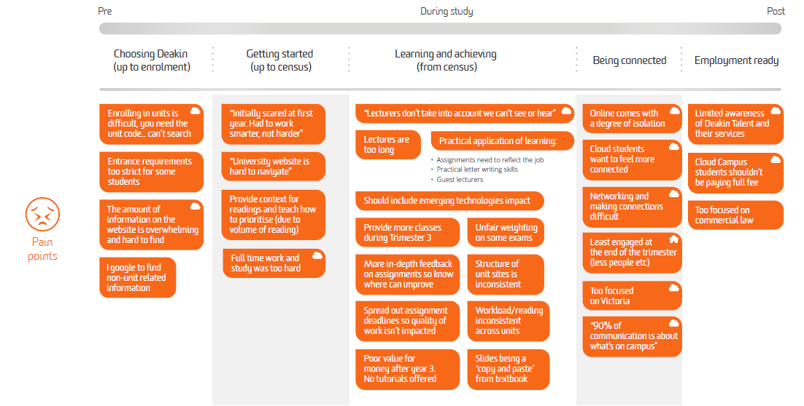
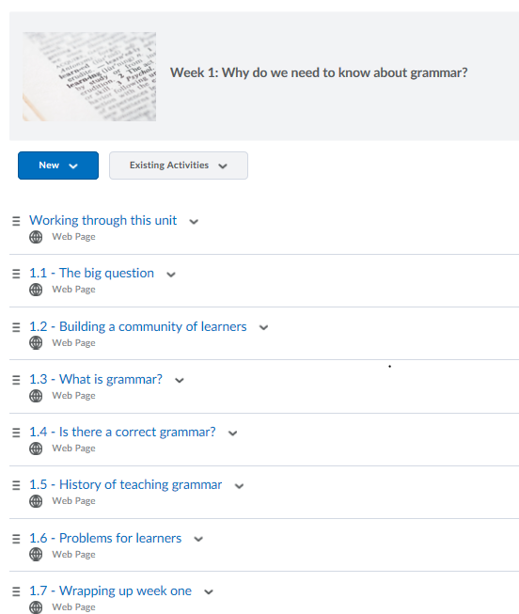
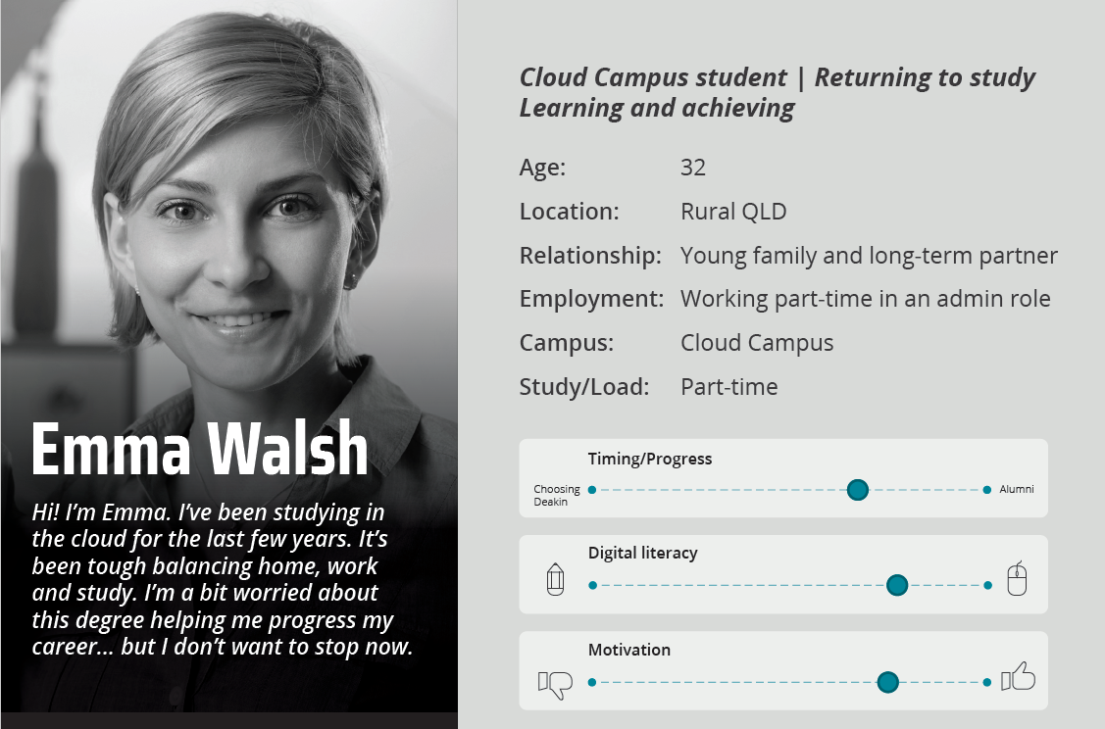
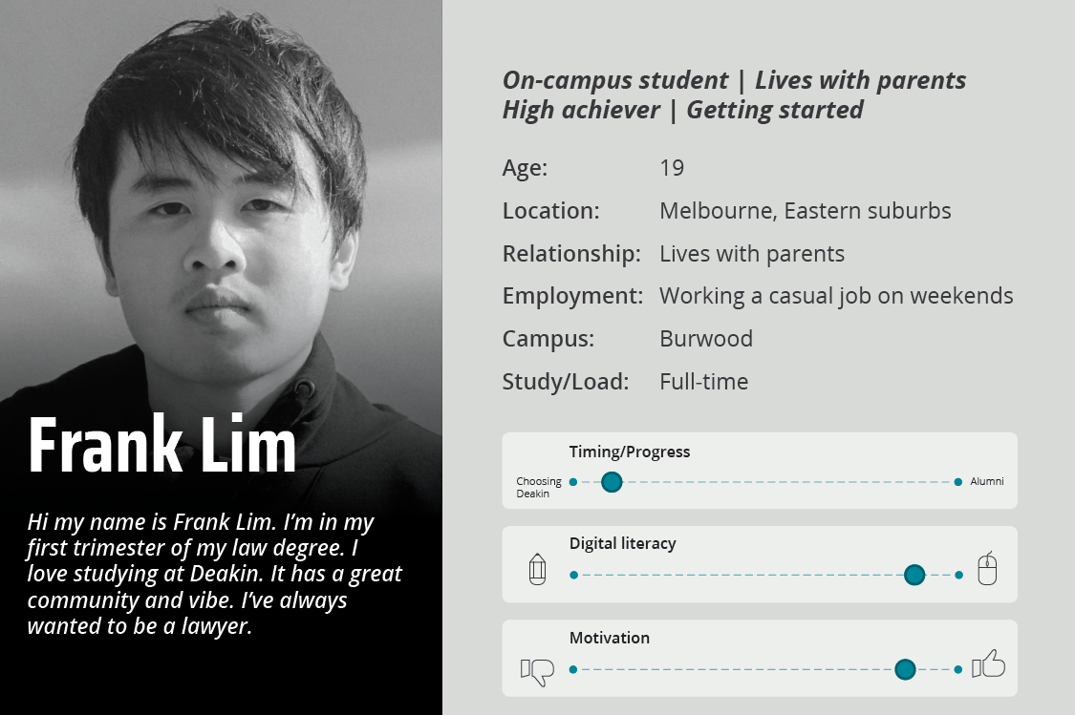
1. Recognise & embrace diversity
ETL700
Notes:
Development of Student Personas (including wants, needs and worries, motivations) and student experience mapping with pain points, but also moments that matter or are working really well.
We also talk explicitly about developing a community of learners, and discuss netiquette

Slide 15
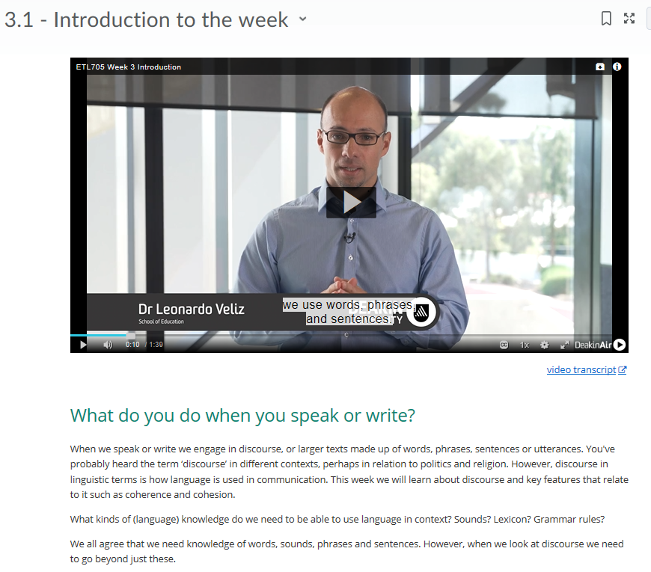
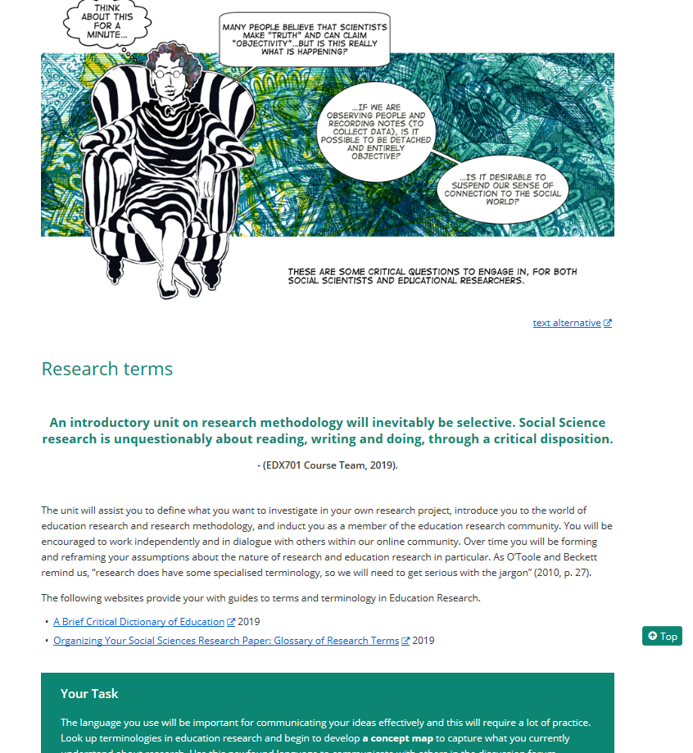
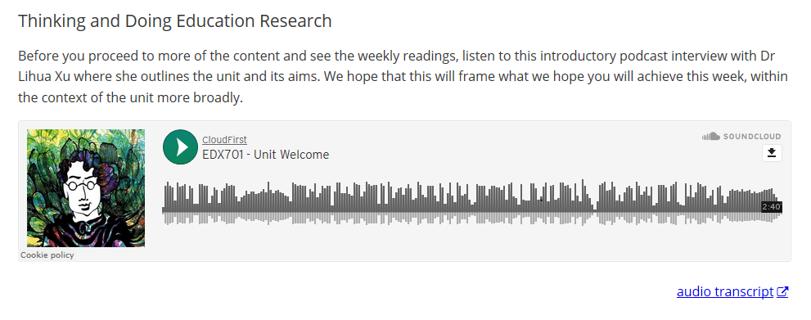
2. Create accessible and usable learning resources
ETL706
EDX701
Notes:
Accessibility of all resources for all students. Text alternatives open to a html page
Transcripts and captions for all videos
Audio transcript for podcasts
Text alternatives for H5P objects
Mix of media –so not just text (Principle 3)
Sufficient colour contrast
Hyperlinks use descriptive text –no ‘click here’

Slide 16
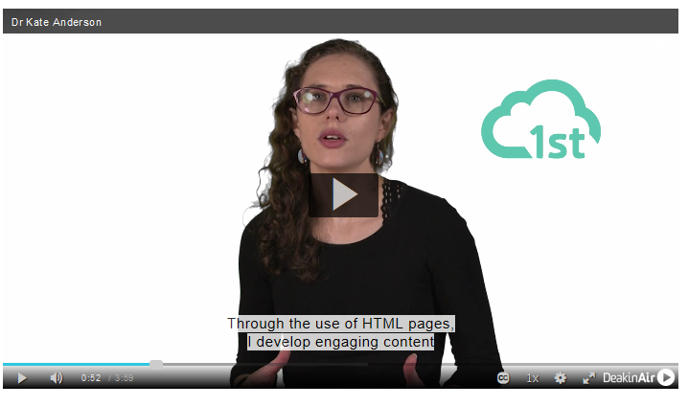
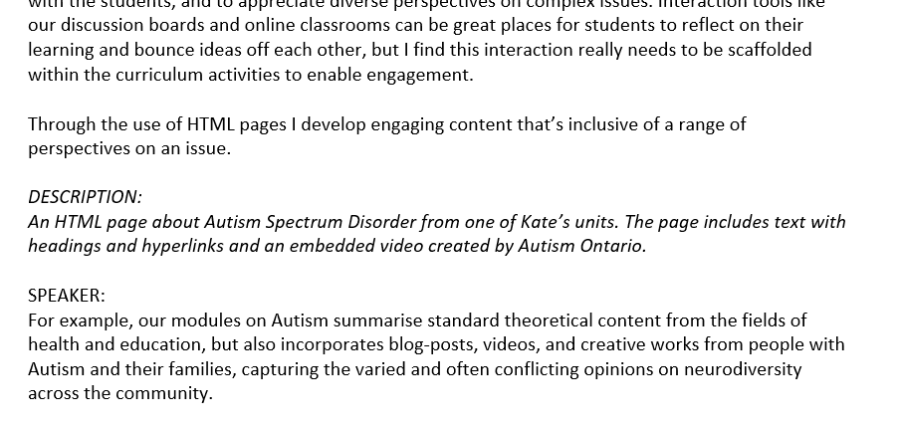
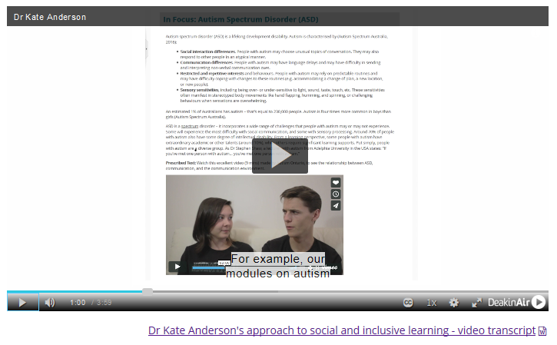
2. Create accessible and usable learning resources e.g. 2
CloudFirst 101
Notes:
Audio description modelled in CF101 –thanks to DA team for guidance with this.

Slide 17
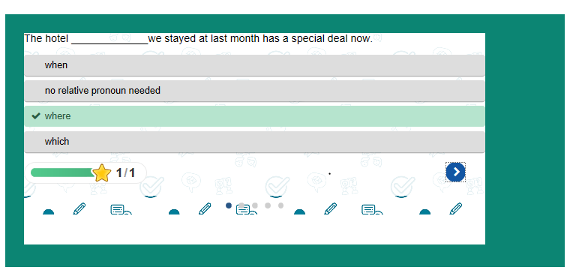
3. Design flexible learning environments – e.g. 1
Apply | Collaborate | Assess/ Evaluate | Investigate | Produce | Discuss | Reflect | Practice | Acquire/Explain: Watch, Listen, Read
ETL705

Slide 18
3. Design flexible learning environments e.g. 2
All students
Purposefully designed online resources
Teacher guided
Peer learning
Active learning
Self-directed
Feedback
3-5 min video
Key concept intro.
Cloud Campus students/
students studying online
On Campus students
Concept elaboration
Active collaborative online seminar
Active collaborative located seminar
Guided reading
‘Call to action’
All students
Active connected class
Peer discussion
3-5 min summary
All students
Authentic assessment or self-check (feedback)
Notes:
Flipped classroom model (if campus component at all) enables flexibility in when students can study to fit in with their lifestyle/other commitments
Teacher guided, so is self-paced.

Slide 19
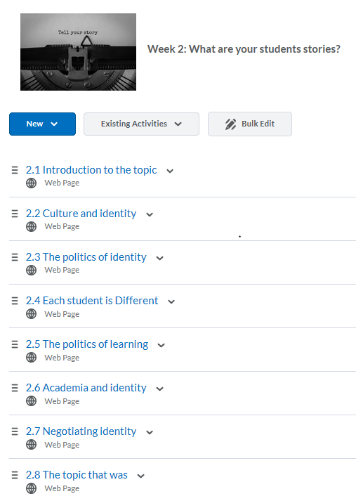
3. Design flexible learning environments – e.g. 3
ETL700
Introduction
Key concept exploration
Interactive/ ‘Call to action’
Wrap-up
Seminar (active learning)
Notes:
Resource level structure. Clear navigation through stepped design so online learners don’t get lost.

Slide 20
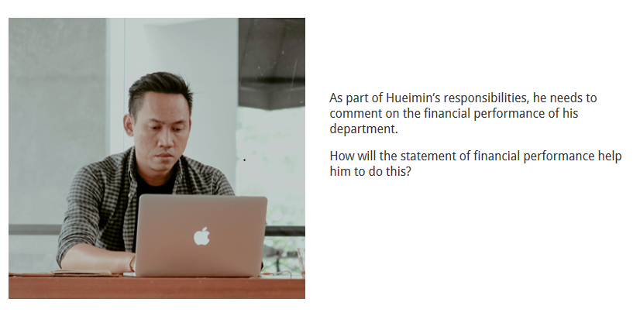
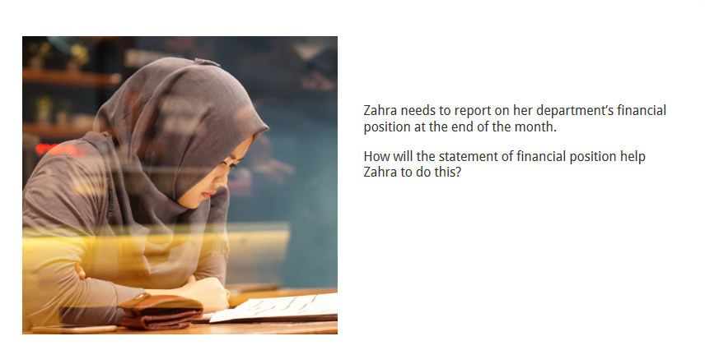
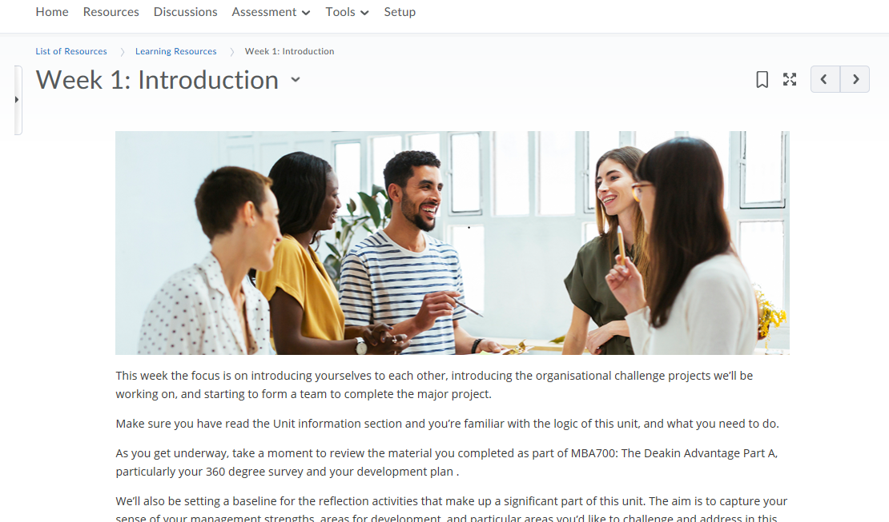
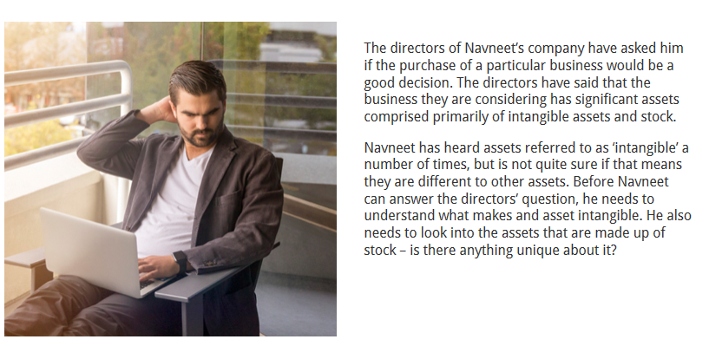
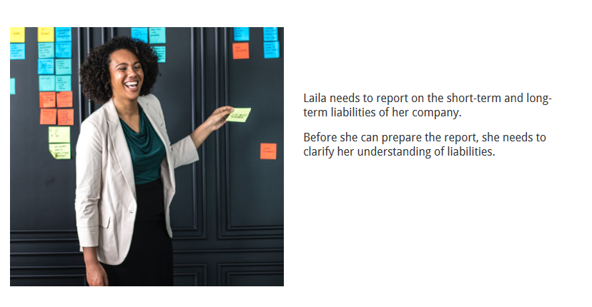
4. Represent diversity in the curriculum
MBA702
MBA707
Notes:
Banner images
Case studies

Slide 21
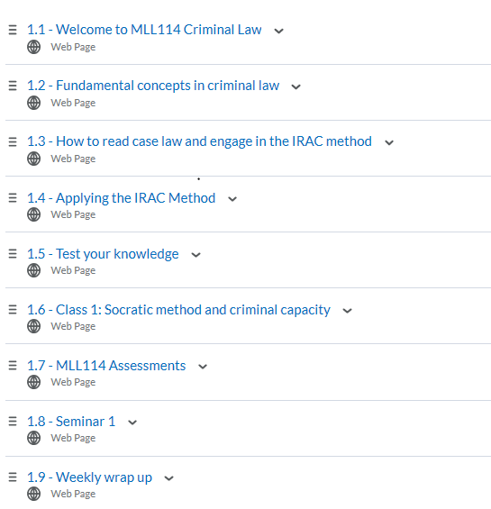
5. Scaffold underpinning knowledge and skills – e.g. 1
MLL114

Slide 22
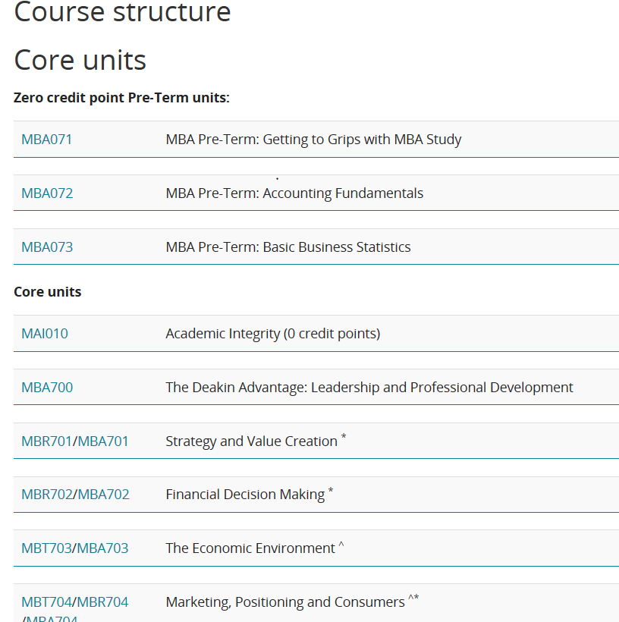
5. Scaffold underpinning knowledge and skills – e.g. 2
MBA

Slide 23
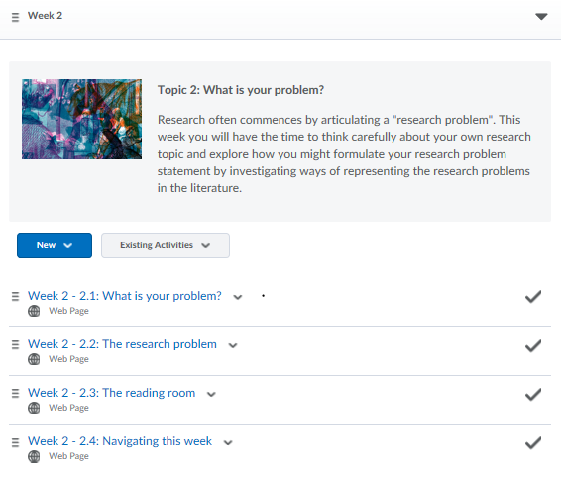
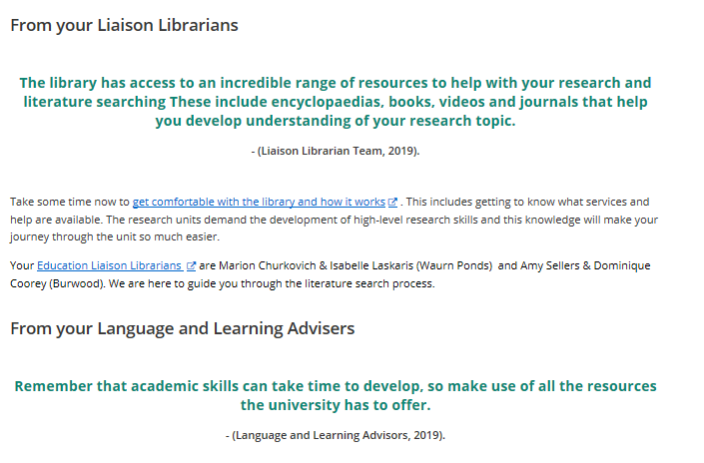
5. Scaffold underpinning knowledge and skills – e.g. 3
EDX701

Slide 24
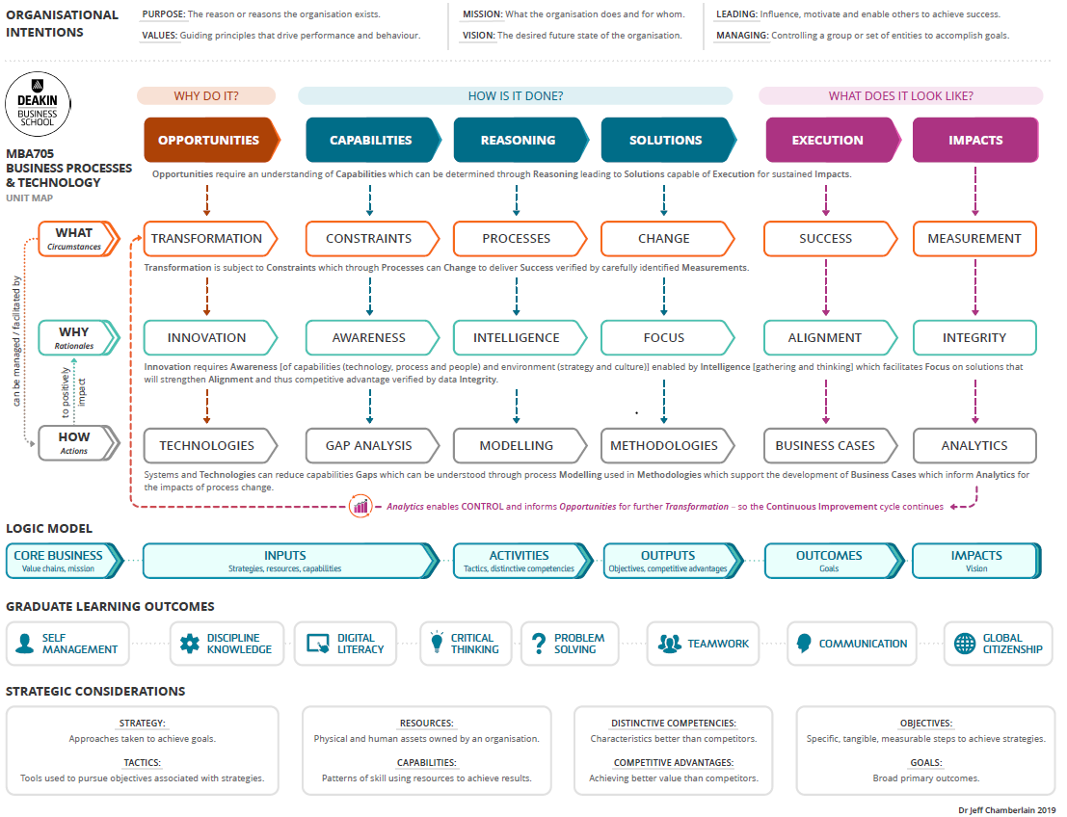
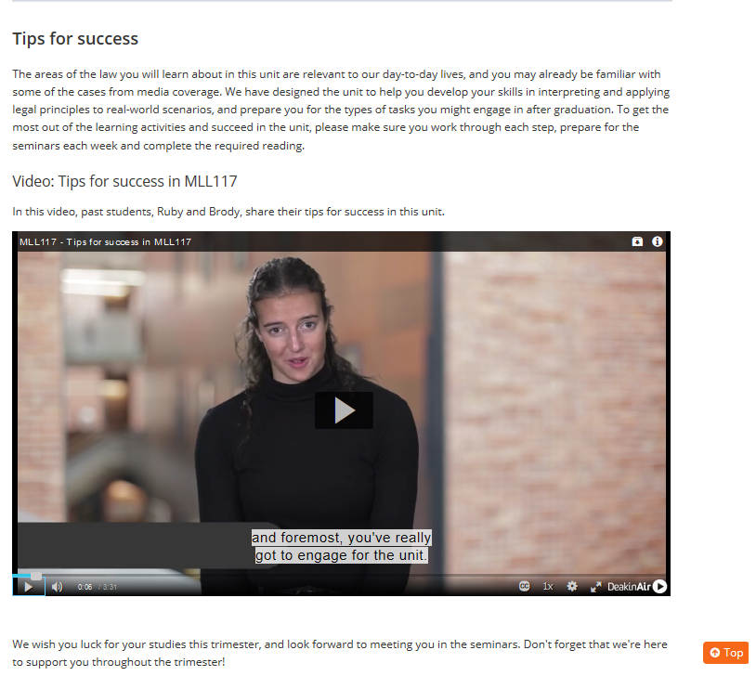
5. Scaffold underpinning knowledge and skills – e.g. 4
MBA705
MLL117
Notes:
Making curriculum links explicit, using past students to highlight knowledge and skills needed for success.

Slide 25
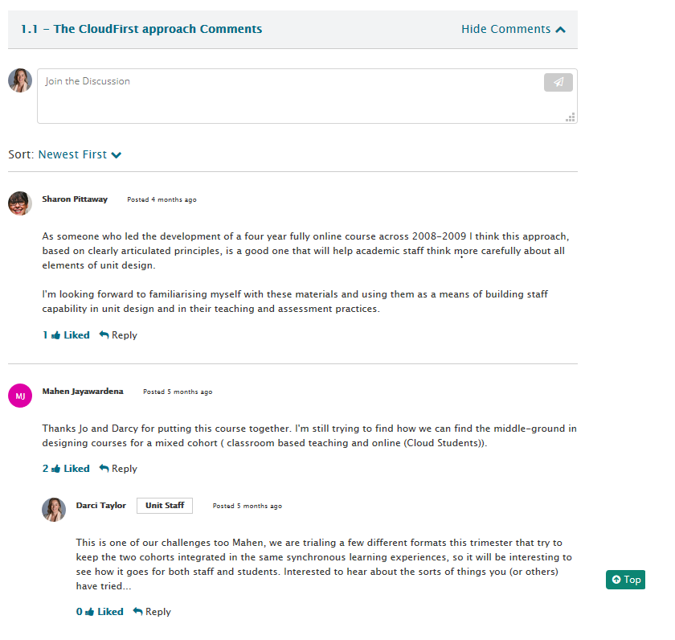
6. Build a community of learners
CloudFirst 101
black
Notes:
Embedded discussion with social media type functionality
Likes, image

Slide 26
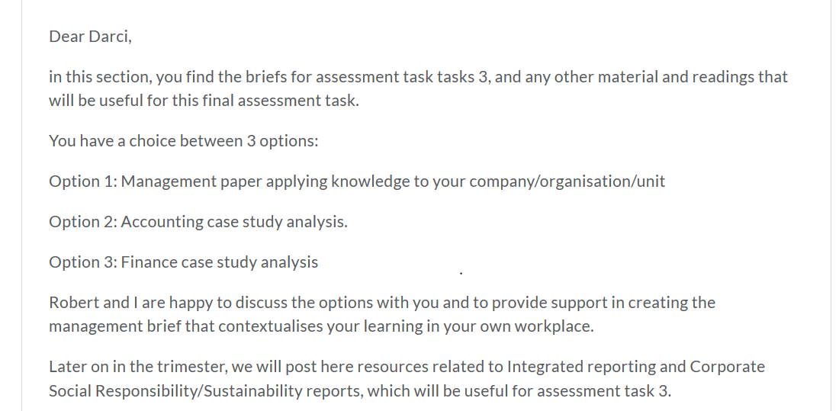
7. Assess equitably
MBA702

Slide 27
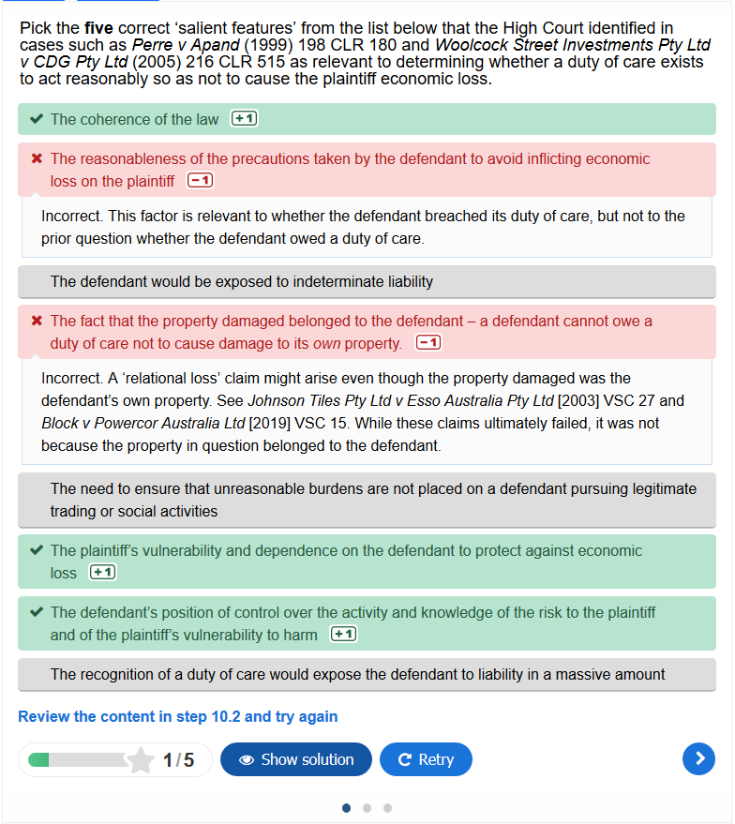
8. Feedback effectively
MLL117
Notes:
Explanatory feedback

Slide 28
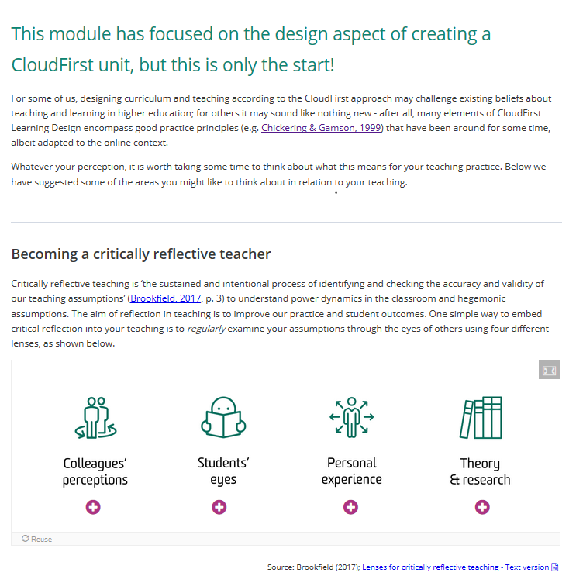
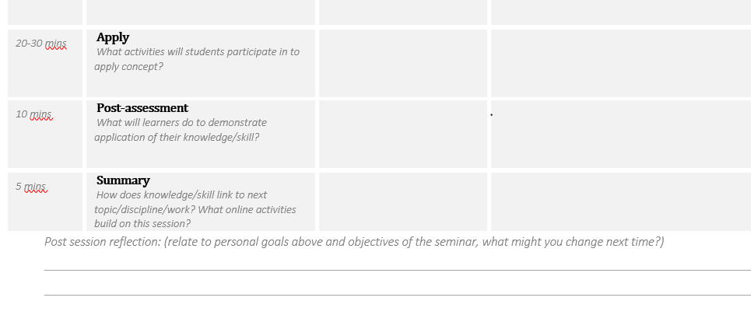
9. Reflect & evaluate practice – e.g. 1
CloudFirst 101
Notes:
Capacity building and templates –eg. lesson plans –reflection, CF101

Slide 29
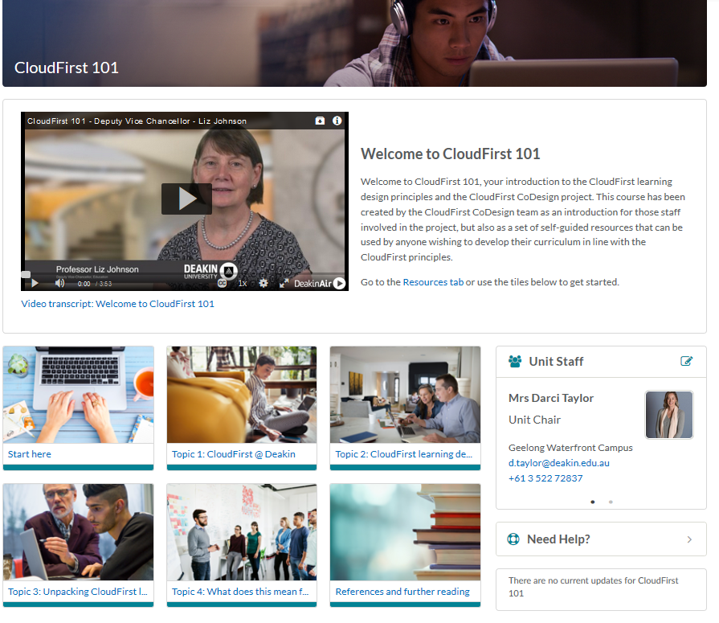
Resources to assist with CloudFirst re-design
Strategy & vision
Models CF approach
Self-directed
Learning design templates
Sharing practice/examples
Reflective practice

Slide 30
Resources to assist with CloudFirst re-design
Under construction:
CloudFirst 102 –practical strategies for teaching CloudFirst units
DLF Seminar Series: CloudFirst Learning Design (26 November, 12-1pm)
2-3 hour tailored workshops for Course Teams

Slide 31

Thank you
  How have you enacted the Inclusive Education Principles in your teaching?
  What challenges have you encountered?

Slide 32
References
Brunton, J., Brown, M., Cleary, A., Costello, E., Delaney, L., Fox, S., Galvin, C., Gilligan, J., O'Regan, L. & Ward, J. (2016). Lost in Transition: A Report on Enabling Success for Flexible Learners. Dublin: Dublin City University
Deakin University. (2019a). Leading Courses Guide. Retrieved from http://dteach.deakin.edu.au/tl-hub/
Deakin University. (2019b). Deakin’s Inclusive Education Principles. Retrieved from https://blogs.deakin.edu.au/iccb/about/deakin-inclusive-education-principles/
Deakin University. (2019c). Accessibility Policy and Guidelines Retrieved from https://blogs.deakin.edu.au/dcoe/standards/accessibility/accessibility-policy-and-guidelines/
Deakin University. (n.d.). Cloud Campus communications toolkit. Retrieved from https://wiki.deakin.edu.au/display/public/CC/Cloud+Campus+communications+toolkit
Strategic Intelligence and Planning Unit (n.d.), Survey reports for Staff (wiki page).

