Slide 1
Diverse beginnings - a focus on belonging through orientation
Corinna Ridley – Deakin Student Life

Slide 2
What we know about our commencing cohort …….
Demographic differences
school leaver
mature age
local
International
ATAR
low SES
first in family
Differences in mindset
Enthusiastic, confident
Apprehensive, anxious
Intrinsically motivated
Extrinsically motivated
Differences in learning preferences
Differences in background knowledge
Differences in previous learning culture and experience

Slide 3
Getting Started at Deakin Survey – 2017

Slide 4
Expect the unexpected………..

Slide 6
The Lizzio model - Griffiths University 2006
It is clear that there isn’t “one right way” to design an orientation and transition strategy. Similarly, there aren’t any guaranteed solutions or “magic bullets” that will impact on student retention or engagement. A reading of the available literature does however indicate that there are consistent needs and concerns that students experience as they commence university. Understanding these needs provides a sound basis for designing effective orientation and transition strategies. (1: 2006)

Slide 7
The Five Senses of Success (Lizzio 2006)
Sense of Academic Culture
.
Sense of Capability
Sense of Connectedness
Sense of Purpose
Sense of Resourcefulness

Slide 8
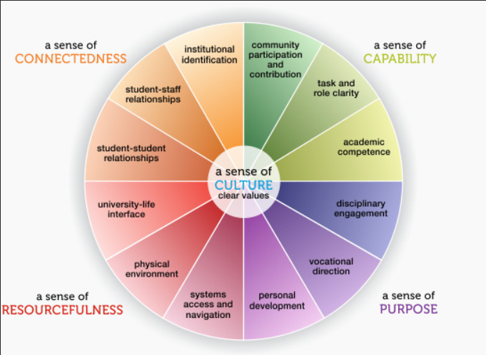

Slide 9
The challenge……
How do we provide opportunities for students to reflect on and develop across all 5 senses during their early weeks at university in ways that acknowledge individual differences?

Slide 10
UniStart – Sense of capability
Self paced Self directed
Assumes student is new to university
Assumes some students know more than others
Assumes some students are more confident than others
Assumes you don’t know what you might need to know…

Slide 11
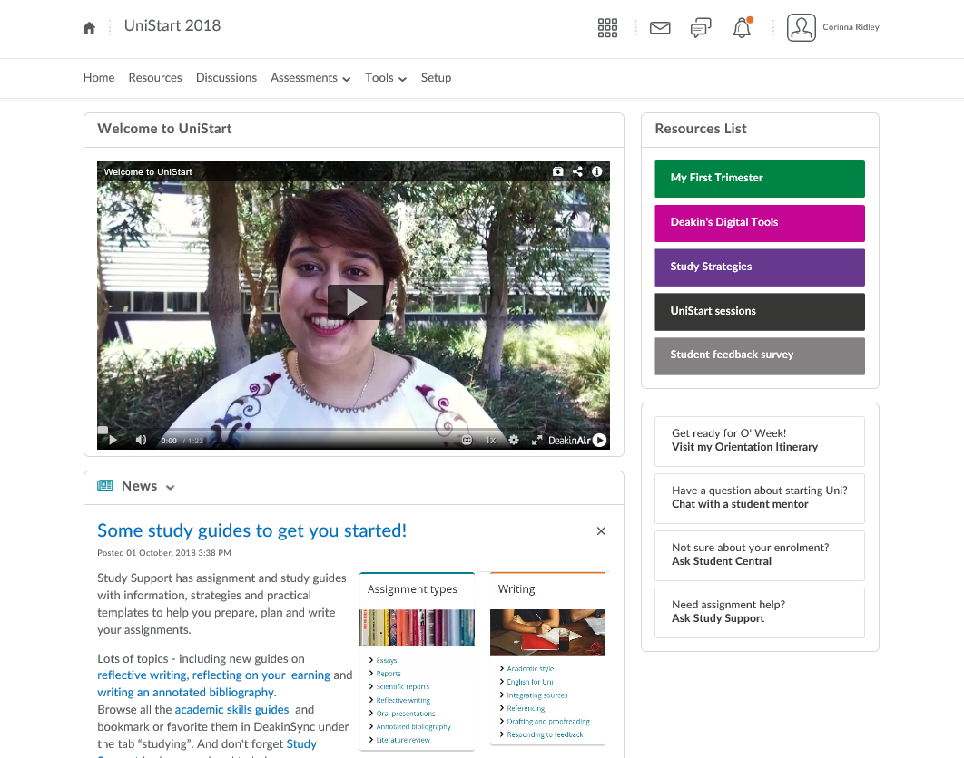

Slide 12
Prepare to Succeed
An orientation program for Post Graduate students who could be:
Recent Deakin students
New to Deakin
Recently completed a degree/completed a degree 5+ years ago
Completed a degree in Australia/overseas
Working full time/part time in related profession
Working full time/part time in an unrelated profession

Slide 13
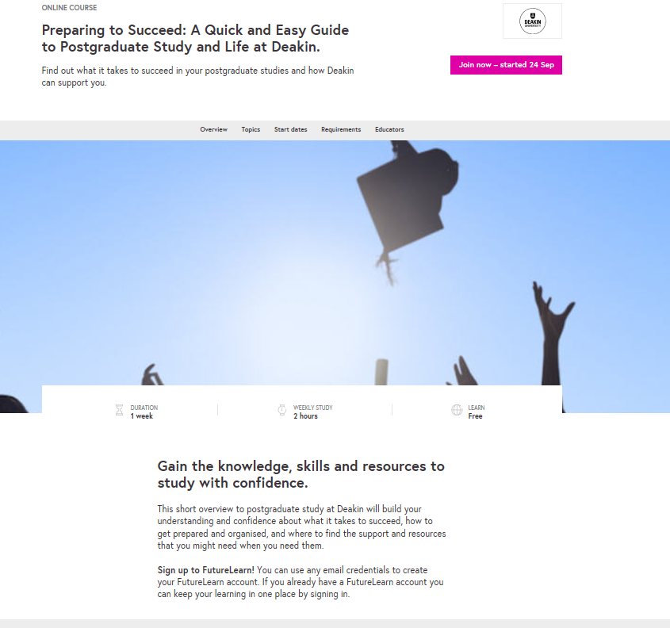

Slide 14
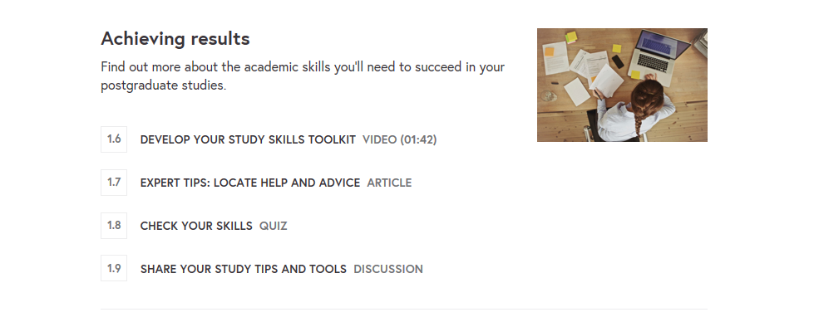

Slide 15
Building Student Engagement and Belonging in Higher Education at a time of change – Liz Thomas 2012
At the individual level ‘belonging’ recognises students’ subjective feelings of relatedness or connectedness to the institution. …….It may relate “the extent to which students feel personally accepted,
Belonging may be characterised by regular contact and the perception that interpersonal relationships have stability, affective concern, and are ongoing (Baumeister and Leary, 1995). Thus interpersonal relations are essential for satisfying the need to belong. (12:2006)
Bourdieu and Passeron’s (1977) theories of cultural capital and habitus view the problem structurally, as being embedded in the way that higher education institutions function. ……
Educational institutions have an identifiable habitus (Reay, David and Ball, 2001), which incorporates practices that mutually shape and reshape the institutions with their students, their communities and the wider socio-economic cultures of their catchment areas (Reay, David and Ball, 2001, para 1.3). Students whose habitus is at odds with that of their higher education institution may feel that they do not fit in, that their social and cultural practices are inappropriate and that their tacit knowledge is undervalued, and they may be more inclined to withdraw early (Thomas, 2002). ( 13:2006)

Slide 16
So what works?
Effective interventions start pre-entry, and have an emphasis on engagement and an overt academic purpose. They develop peer networks and friendships, create links with academic members of staff, provide key information, shape realistic expectations, improve academic skills, develop students’ confidence, demonstrate future relevance and nurture belonging.(15: 2006)

Slide 17
The Success Coach Program for commencing UG Cloud students
Aims to:
build sense of connectedness, capability and resourcefulness
increase engagement and sense of belonging
Assist students to navigate the online learning landscape

Slide 18
Who are success coaches?
Success coaches are experienced later years students from the same or similar discipline
Success coaches email all students in the group every week from 2 weeks before O week to week 8
Invite questions/queries/ comments from students
Respond to questions/queries/ comments by email and/or phone or skype

Slide 19
A key premise of the program is that the student and coach can relate as peers, share common experiences, and the more experienced student can help break down barriers to seeking help, connecting the new student with university supports and with peers.

Slide 20
Mentoring essentials? The advantages and challenges of the online environment
Peer mentoring – a two way relationship is central
Email – a ‘one way’ communication model ?
Peer mentoring - not just giving advice ?
Guest (2000) argued that mentoring is a long-term process, involves sharing experiences and offering encouragement, provides the mentee (protégé) with a way of developing insight through reflection, and is a two-way relationship that results in mutual learning.
Guest 2000 cited in Shrestha et al (2009: 116)

Slide 21
Success coach data - 2018
Trimester | Total in cohort | Total contacting coach at least once | Most active wks for student contact | Popular links*
T1 2018 | 945 @ wk – 2 1431 @ wk 1 1646 @ wk 4 1469 @ wk 8 | 519 35% of final cohort 31% of max cohort | Wk 1 (190) Wk 2 (156) 0 – 2 (132) | Staying motivated blog (184) Cloud communities group (146) UniStart (121)
T2 2018 | 434 @ wk -2 570 @wk1 916 @ wk3 785 @wk 8 | 234 30% of final cohort 25% of max cohort | 0-2 ( 71) Wk 1( 70) Wk 3 (59) | Orientation itinerary (110) Assignment planner (61) UniStart (55)

Slide 22
Other initiatives
Unified orientation project – what messages do all students need? Which channels are best for that communication?
Customised orientation for HDR students, pathway students, International students, Cloud students
Personalised orientation itinerary

Slide 23
What’s next ?
Transition toolkit – to assist academic staff to embed activities that build students’ ‘sense of capability’ into early units of study.
Success coaches for other cohorts ?
Graduate Certificate in Humanitatirun Leadership
Deakin Accelerate students

Slide 24
References
Lizzio, A. (2006). Designing an orientation and transition strategy for commencing students. Retrieved from http://www.griffith.edu.au/__data/assets/pdf_file/0008/51875/Alfs-5-Senors-Paper-FYEProject
E. Thomas ( 2012) Building student engagement and belonging in Higher Education at a time of change: final report from the What Works? Student Retention & Success - Higher Education Academy
Shrestha, Celayne Heaton; May, Steve; Edirisingha, Palitha; Burke, Linda; Linsey, Tim ( 2009) From Face-to-Face to e-Mentoring: Does the "e" Add Any Value for Mentors? International Journal of Teaching and Learning in Higher Education, v20 n2 p116-124 2009

