Slide 1
Teaching diverse learners
Inclusive Curriculum and Capacity Building Project,
Equity and Diversity Division
Dr Janet Watson (Burwood)
Dr Kathryn Keeble (Burwood)
Dr Mary Dracup (Geelong)

Slide 2
Video
Higher Education https://deakin.kanopystreaming.com/video/higher-education
While watching, make quick notes on:
The kinds of challenges these types of students would face at Deakin.
What might help overcome/avoid these challenges.

Slide 3
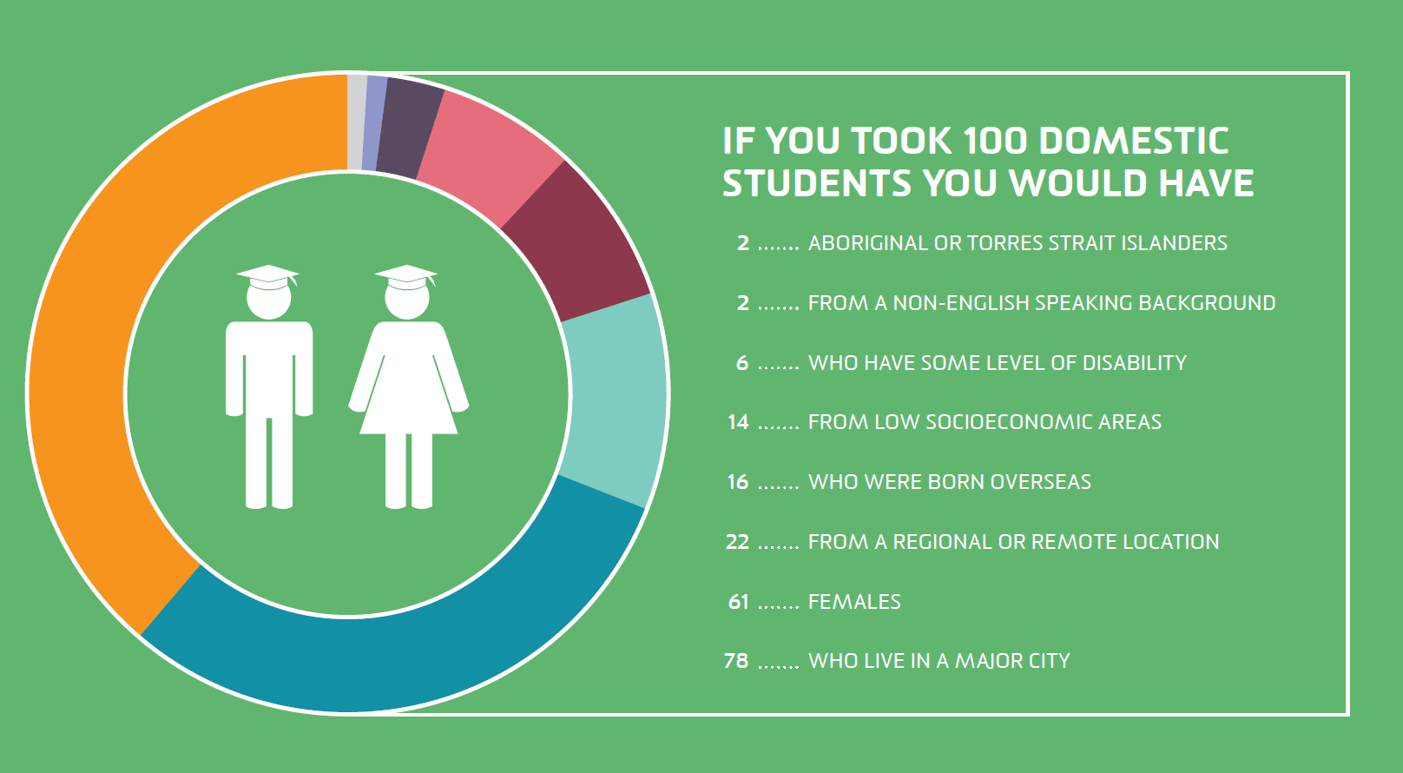
Diversity
What do you see as the diversity of your student cohort?
Deakin has a very diverse community of students and staff from over 126 distinct countries.
We have the highest number of students registered with a disability of any university in Australia and encourage the participation of different equity groups.
LIVE the Future Agenda 2020
Notes:
Widening participation agenda means our student cohorts are increasingly diverse with increasing enrolments from equity groups such as LSES, first-in-family, rural/remote, ATSIC, mature-age, International/CALD/ESL, disability etc.
Academic teaching staff, particularly new and sessional, may encounter such diversity as a problem: first year and transitioning students often lack university preparedness re academic and digital literacies.
The aim and importance of ICCB is to promote awareness and knowledge about inclusive teaching pedagogy and curriculum design, whereby you approach diversity in the classroom/cloud as a rich resource to be drawn on rather than as a barrier or problem.
HEPPP funding targeted Success sand Retention of low SES students
However our Universal Design approach is that when you design T&L to benefit one equity group you benefit all students

Slide 4
What is inclusive teaching?
'Inclusive learning and teaching in higher education refers to the ways in which pedagogy, curricula and assessment are designed and delivered to engage students in learning that is meaningful, relevant and accessible to all. It embraces a view of the individual and individual difference as the source of diversity that can enrich the lives and learning of others'.
Professor Christine Hockings, April 2010
Inclusive learning and teaching in higher education: a synthesis of research

Slide 5
Universal Design for Learning (UDL)
Anticipates learner diversity and minimises the need for individual accommodation or adjustments to benefit ALL students.
Provides choices, options and flexibility for students:
to gain knowledge using different modes of content delivery—multiple means of representation.
to demonstrate knowledge using different activities and tasks—multiple means of expression and action.
to interact with their teachers, fellow students and study materials—multiple means of engagement.
Burghstahler (2015), Universal Design of Instruction (UDI): Definition, Principles, Guidelines, and Examples, Washington University.

Slide 6
Inclusive teaching checklist
Refer to the handout: Inclusive Teaching Checklist.
Choose one or two checklist questions that resonate for you from your own teaching experience.
Discuss in pairs/groups what you could do in your teaching practice to address these questions. Think of specific actions or activities you might undertake.

Slide 7
Learning Access Plans (LAPs)
Communication tool between faculty, DRC and students with a disability.
Provide information on strategies to better support individual students:
Individual arrangements
Inclusive practices: physical access, accessible technology, student support, inclusive teaching practices.
Notes:
Key message: is that LAPs are all about inclusive practice, which is the hook to our project, and to minimise the need for individual adjustments, even though these are necessary in particular circumstances.
LAPs: communication tool that between DRC/student and faculty that outlines how to maximise the educational experience for these students (and meet our obligations under the Discrimination Act)
Students are the best experts in what works for them. They have developed some very good techniques in previous education, have access to specialist support and know their own strengths and limitations better than anyone. They come to the DRC with specialist reports and assessments, recommendations etc
Sections on the LAPS:
Information about the student and their disability or health condition
Adjustments to the academic program (arranged by the Faculty)
Examination adjustments (arranged by DSA)
Other Services
Approval
DRC Contact details
INDIVIDUAL ARRANGEMENTS
interpreters
assistive technologies
note-takers
need alternative assessment arrangements
will require specific arrangements to access education (such as transcripts/captions/alternative formats).
INCLUSIVE PRACTICES
Physical access –when we get this right many don’t need anything else.
Accessible technology – accessible software – text to audio, screen enlargers etc that are useful for many not just people who have a disability.
All computer labs also now include this software
Assistive software available from Deakin software library
Student support –
Language and Learning advisers, writing and math mentors
Faculty mentor program,
Division of Student Life: counselling, medical services, Safer Community, International Student Advisers etc
DUSA: social and recreation clubs; advocacy (e.g. for Academic Progress and Disciplinary hearings), legal advice, financial assistance, accommodation, survival kits
Teaching practices – effective and inclusive teaching practices.
This is where ICCB project provides support and resources to teaching staff.
The more we embed inclusive teaching as core practice university-wide we lessen reliance on individual adjustments and the need for LAPs.

Slide 8
Learning Access Plans (LAPs) FAQs
Do all students with a disability have a Learning Access Plan?
What do Unit Chairs need to do when they receive a Learning Access Plan?
What is the responsibility of the student?
What do you do if you are unsure about implementing the LAP?
See LAP FAQs
Notes:
Not all students with a disability will identify on enrolment– concerned about discrimination, not seeing it as relevant, not realising that it will impact, not seeing themselves as having a disability (health condition, mental health issues, etc)
Not all register with the DRC as their disability may not impact on access to study. For example – you may be surprised to know that there are a number of students who use wheelchairs who are not registered – if they can get around and access all classes there is not need to register.
Why would they not register with DRC?
Maybe they don’t have any difficulties in accessing and participating in study
Maybe they do not identify as having a disability
Maybe they don’t know that they could receive some assistance
Maybe they have made individual arrangements with faculty and receiving other supports
Communication of LAP document
Emails sent to both UC and students with explicit instructions on their responsibilities.
Responsibility of UC when receiving a LAP
circulate to all staff involved in teaching the student
Student’s responsibility
Students are encouraged to make contact with UC/tutors to ensure they are aware of the LAP and to discuss arrangements.
Contact the DRC if unsure about any aspect of a LAP you have received an how to implement it.

Slide 9
Accessibility starter tips
Use formatted heading levels
Use formatted lists (bullet and/or ordered)
Provide alternative text to images
Provide transcripts for all multimedia and accurate captions for videos
Use colours with sufficient contrast
Use easy to read sans serif fonts (Calibri, Arial)
Make links meaningful: avoid 'click here' and 'read more'

Slide 10
Quick inclusive teaching tips
Make expectations explicit and give clear instructions for activities, assignments, and set readings in plain language.
Offer opportunity to gain digital literacy and technology skills (e.g., library tutorials).
Deliver content and engage students in multiple ways (e.g., in a combination of text, video, image).
Accommodate a range of language skills (e.g., spell acronyms, avoid/define jargon, avoid colloquialisms).
Use examples that are relevant to diverse interests and backgrounds.
Offer outlines, annotations and other scaffolding tools

Slide 11
Inclusive teaching resources at Deakin
ICCB Inclusive Teaching WordPress
Inclusive Teaching Toolkit
Digital Centre of Excellence (DCoE)
Guidelines, tips & standards for creating accessible digital work.
Health Innovative Learning and Teaching Network (HILTN) Inclusive Learning Series
Teaching and Learning at Deakin (sessional staff)
DLF CloudDeakin capacity building module.
Self-register from CloudDeakin home page.

Slide 12
Thank you!
For any information regarding the ICCB inclusive teaching resources or staff training please contact:
Dr Janet Watson: janet.w@deakin.edu.au

