Slide 1
Robyn Everist
Project Manager,
Inclusive Curriculum and Capacity Building
(Equity and Diversity)

Slide 2
Learning outcomes
Participants will:
Explore strategies based on the Universal Design for Learning model, to engage all students in their classes
Plan a teaching session using strategies that will engage the diverse learners in their classes

Slide 3
Pre- session work discussed
Question for consideration: What is your current understanding of inclusive teaching?
Participants to watch the YouTube video “From Bach to Lady Gaga”
Participants to have a look through the Cloud campus module “Inclusive Teaching in Higher Education”
Questions following completion of the above :
What is your understanding now of Universal Design for Learning?
How do you think some of these ideas could be implemented into your teaching practice?

Slide 4
icebreaker
List all the things your group have in common
Rules:
You are not able to list body parts but you can list things like you all drive a car to work here at Deakin

Slide 5
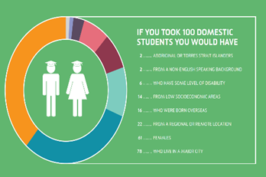
diversity
What do you see as the diversity of your student cohort?
Deakin has a very diverse community of students and staff from over 126 distinct countries.
We have the highest number of students registered with a disability of any university in Australia and encourage the participation of different equity groups.
LIVE The Future Agenda 2020

Slide 6
Diversity in school of a+b
What do you know about your learners?
How does that impact the way you teach?
How do you engage your learners?
How does the diversity of your student cohort enable opportunities for you as a teacher?

Slide 7
Define and explore inclusive teaching
What does the phrase inclusive teaching mean to you?
Discuss this question in pairs
Please write up your list.
Feedback key points from your discussions
'Inclusive learning and teaching in higher education refers to the ways in which pedagogy, curricula and assessment are designed and delivered to engage students in learning that is meaningful, relevant and accessible to all. It embraces a view of the individual and individual difference as the source of diversity that can enrich the lives and learning of others'.
Inclusive learning and teaching in higher education: a synthesis of research Professor Christine Hockings, April 2010

Slide 8
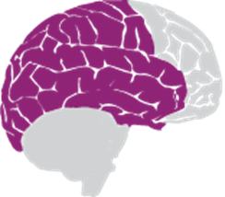
Defining universal design for learning
Multiple Means of Representation
Multiple Means of Action and Expression
Multiple Means of Engagement
Recognition Networks
The "what" of learning. For resourceful, knowledgeable learners, present information and content in different ways.
Strategic Networks
The "how" of learning. For strategic, goal-directed learners, differentiate the ways that students can express what they know.
Affective Networks
The "why" of learning. For purposeful, motivated learners, stimulate interest and motivation for learning.

Slide 9
Exemplars of inclusive teaching
In small groups discuss:
• What strategies do you think are effective examples of inclusive teaching?
• How do these activities help students to reach their potential?

Slide 10
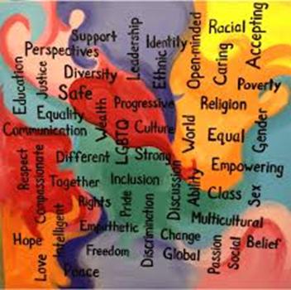
Plan Your own session!
What can you do in your session/units?
Plan your own session using the principles of inclusive teaching.
What are your learning outcomes?
Complete the activity sheet
Present this to your partner/group- discuss
How will you evaluate how inclusive your teaching has been?

Slide 11
Thank you and reflections
1. How has your understanding of inclusive teaching changed from attending this session?
2. How do you intend to use the information from this session in your teaching?
3. How can we improve on this session?

