Slide 1
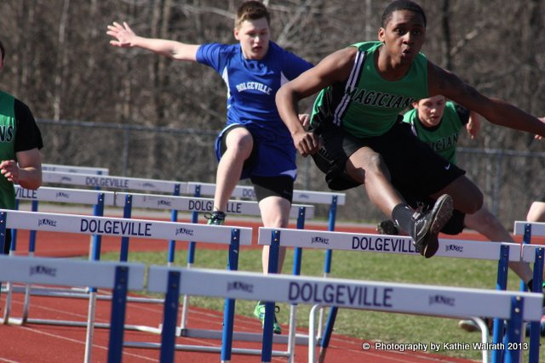
Hurdle jumping in the Cloud: Using video and annotated documents to decode academic texts and expectations
Dr Mary Dracup, Dr Tanya King, Dr Shaun Rawolle, Juliet Austin
Image: IMG_9153 by K8tilyn, flickr, available under Creative Commons Attribution (CC BY 2.0) Generic licence
Notes:
Apologise for absence of Tanya and Shaun
Reporting on a HEPP-funded inclusive curriculum project in Arts-Ed with a working group including Library, DSL and Equity and Diversity staff – preliminary results only

Slide 2
 | No. of marks | Median | Mean
All Deakin students T2 2015 | 33,736 | 66 | 59.5
Low SES students | 3,958 | 65 | 58.1
Regional or remote students | 7,215 | 68 | 61.9
Non-English speaking background students | 2,638 | 63 | 58.1
Women in non-traditional areas | 4,972 | 66 | 61.1
Students with disability | 1,999 | 65 | 57.8
Aboriginal and/or Torres Strait Islander students | 346 | 56 | 42.9
Low ATAR students (<60) | 2,387 | 59 | 52.0
Deakin College pathway students | 763 | 61 | 57.3
Cloud students | 3,306 | 64 | 53.6
First in family students | 13,820 | 66 | 59.9
Mature age students | 9,002 | 67 | 58.5
International students | 2,717 | 63 | 58.4
Notes:
To set the context - T2, 2015 Deakin results. Note the lower than mean scores for many student groups (in red)
In Arts-Ed, the project aims to cater better for diverse student cohorts by:
strengthening understanding of inclusive curriculum design and pedagogy
building academic staff capacity to apply these principles in their teaching.
We focused on developing inclusive curriculum and staff capacity building in 2 units and evaluating the results.

Slide 3
Inclusive curriculum
An inclusive curriculum design approach is one that takes into account students’ educational, cultural and social background and experience as well as the presence of any physical or sensory impairment and their mental well-being. It enables higher education institutions to embed quality enhancement processes that ensure an anticipatory response to equality in learning and teaching.
(Higher Education Academy UK 2011, Inclusive curriculum design in higher education, p. 3)
Notes:
What is inclusive curriculum?
Not add-ons for students with particular difficulties, it’s making the curriculum more accessible for ALL students, from the outset.

Slide 4
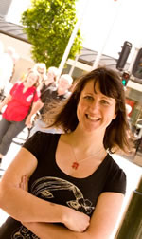
ASS234 (Environmental Anthropology)
High proportion of students from varied academic backgrounds, first-in-family, low-SES
Cloud students, from across disciplines
Difficulties:
Reading Anthropology readings
Understanding expectations of Anthropology students
Strategies:
‘Explain Everything’ videos to highlight, explain expectations in unit guide
Videos, annotated PDFs and Word docs of key readings
Video of past Anthropology student’s strategies for success
Students create one-page visual ‘fact sheets’ to lead weekly tutorials
Dr Tanya King
Notes:
Pre-test showed links between willingness to participate and confidence with understanding of texts, many complaining about difficulty of academic language
Show excerpts in CloudDeakin:
Video commentary of unit guide
Explain Everything video: Reading anthropology texts (with quiz)
Week 1: Milton PDF annotated reading
Strategies for success video

Slide 5
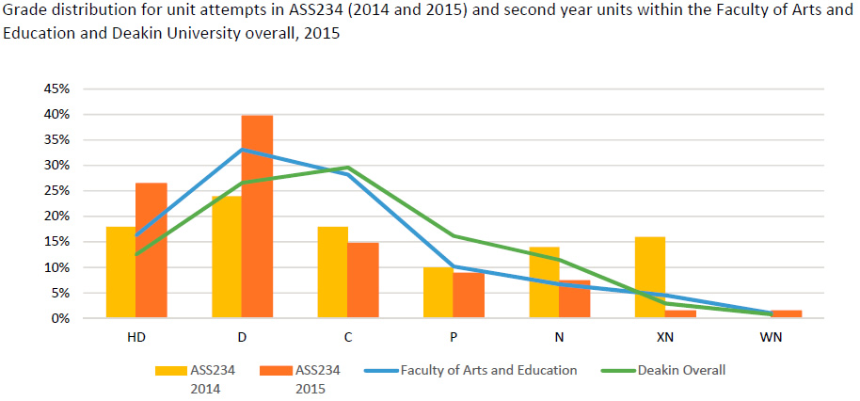
Notes:
Grade distribution for the unit in orange bars for 2015, yellow for 2014, and Faculty and Deakin overall in 2015 in blue and green lines.
A noticeable improvement in grades this year.

Slide 6
Unit cohort | Success rates (%)
 | ASS234 2014 | ASS234 2015 | Faculty of Arts and Education | Deakin Overall
All unit attempts | 69.3% | 88.9% | 87.7% | 84.6%
Unit campus
Cloud (online) | 58.5% | 89.6% | 82.0% | 80.9%
Geelong Waurn Ponds | 85.7% | 87.8% | 89.2% | 84.9%
ATAR group
Low ATAR (<60) | 66.7% | 85.7% | 80.7% | 79.6%
Mid ATAR (60 - 80) | 63.2% | 100.0% | 90.8% | 87.5%
High ATAR (>80) | 100.0% | 100.0% | 95.5% | 94.2%
Equity groups
Low SES students | 87.5% | 100.0% | 81.9% | 82.6%
Other students | 67.5% | 86.1% | 88.4% | 84.9%
Regional or remote students | 73.7% | 90.9% | 86.7% | 87.5%
Other students | 66.0% | 87.8% | 87.9% | 83.9%
Non-English speaking background students |  | 100.0% | 88.3% | 77.3%
Other students |  | 88.7% | 87.6% | 85.7%
Students with disability | 66.7% | 83.3% | 82.8% | 82.8%
Other students | 69.6% | 89.5% | 88.0% | 84.7%
Women in non-traditional areas | 0.0% | 83.3% | 90.6% | 84.0%
Other students | 70.9% | 89.5% | 87.5% | 84.7%
Aboriginal and/or Torres Strait Islander students | 33.3% | 100.0% | 62.8% | 60.0%
Other students | 72.0% | 88.7% | 87.9% | 84.8%
First in family students | 74.5% | 90.2% | 88.1% | 86.0%
Other students | 63.4% | 87.7% | 87.4% | 83.7%
Notes:
Notable improvements in success rates for:
Cloud students
Regional/remote
First in family
(other groups with red scores had less than 10 students)

Slide 7
Student responses
On annotated readings
‘I found them really helpful, to focus on what she wanted us to focus on in the article, rather than me just hoping that I’d got the gist of the idea kind of thing. So I found them really helpful’ (focus group)
‘It seems so much more relevant when you’re reading it on the pdf than if it’s a separate study guide, and … study guides have a tendency to get really loaded’ (focus group)
‘I have greatly appreciated the annotations that you have included in this unit's readings. It has helped me to link the information together and at times when a paragraph is heavy with info, it has helped to break it down into digestible bits’ (survey)
Notes:
Many, many responses in the focus group and survey on how helpful the annotated readings in particular were to helping students jump the hurdle of decoding academic texts

Slide 8
Teacher responses
On video commentary of unit guide
‘I noticed a big drop-off in the thousand and one questions that you get at the start of the semester—I’ve already answered them … it encouraged them to look closely at the unit guide, which they are supposed to do anyway, but it encouraged them to do that ’ (interview)
On the impact of the new resources and activities
‘Certainly the quality of the presentations in class … to me indicates that they’ve understood the readings much more thoroughly, they’ve really taken the time to pull out some of the key ideas and they’ve done that consistently, so it’s not just the brilliant students who’ve done it and the rest have done OK, they’ve all done a good job, I find that they’re all getting very good marks, so that’s a good thing. I feel like they are understanding the readings in much more depth, which means that we are able to all discuss them in a lot more detail’ (interview)
Notes:
Tanya’s thoughts (in very brief form) on how effective the interventions were

Slide 9
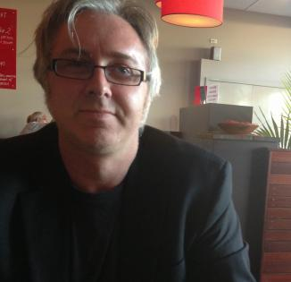
ETP102: Social contexts of education
High proportion of students with varied academic backgrounds, first-in-family
Large student numbers, across campuses
Difficulties:
Complex readings and concepts
Multi-part assignments
Strategies:
Infographic of assignment requirements
Videos on decoding policy texts, advice from a former student
Annotated docs of key readings
Librarian lecture spot and narrated PPT to help find resources for particular assignments
Formative peer assessment activity
Dr Shaun Rawolle
Notes:
Show resources in CloudDeakin Geelong/Groupwork and Assignment 2 Resources/Read this first
Too early to publish the results of this intervention – not all data is in.
Peer assessment activity seems to have been most successful intervention, from student focus group and teacher conversations so far.

Slide 10
Preliminary conclusions
Video and text-based annotations to key documents such as unit guide, key readings CAN help decode and demystify academic texts and explain expectations
Provide transcripts or text equivalents, eg annotated PDFs and Word docs, to increase access
Promote the resources in class, in news items
Make them easy to find on CloudDeakin
They MUST be timely for students
Target efforts to most important documents, they can take time to create
Division of Student Life can advise on reading strategies, key questions
Library can help students find and evaluate good resources
Teach Assist can advise on video making, Explain Everything, DeakinAir, etc.

Slide 11
http://www.deakin.edu.au/clouddeakin

