Slide 1


Embedding inclusive curriculum: Working from the ground up
Dr Mary Dracup
Dr Nadine Zacharias
Robyn Everist
Deakin University Equity & Diversity Unit

Slide 2
Contents
Context and introduction to the project: Inclusive Curriculum and Capacity Building (ICCB)
Research context
Overview of initiatives: ICCB projects 2014-17
Two case studies of practice
Discussion of enablers and barriers
Notes:
Discussion paper: Supporting under-prepared students at Deakin University using Transition Pedagogy (2010, p.1) “Deakin University needs to develop an institutional response to this political imperative [40/20 participation target] and a strategy to successfully transition increasing numbers of low SES students into the University and support a very diverse student cohort at all points of their education journey.”
Eckel & Kezar say transformational change needs to be deep and pervasive, to be far-reaching, involves changes to the status quo
We started with a broad aspiration. There was a gap because nobody was doing it, we had increasing numbers of disability who had increasingly complex needs, plus the rise of technology brought both opportunities and challenges for people with diverse needs. (Again, the driver was catering for disability)

Slide 3
Context
The Deakin context for developing inclusive curriculum and capacity building activities from the ground up (2009/10)
  Drivers of change: national policy agenda to widen participation and the reality of an increasingly diverse student cohort, incl. students from low SES backgrounds and students with disability
  Institutional gap in thinking and practice: no dedicated area with interest in or responsibility for inclusive approaches to teaching and learning
  Opportunities: HEPPP funding and the increased adoption of technology-enabled delivery methods
Emerging knowledge about diverse student cohorts and models to support them well:
  Non-traditional students in the UK (Crozier and Reay) and US (Tinto, Kuh)
  Equity student experiences in Australia, incl. financial stress (James, Krause, McInnes, Devlin)
  Transition pedagogy (Kift and Nelson)
Notes:
Discussion paper: Supporting under-prepared students at Deakin University using Transition Pedagogy (2010, p.1) “Deakin University needs to develop an institutional response to this political imperative [40/20 participation target] and a strategy to successfully transition increasing numbers of low SES students into the University and support a very diverse student cohort at all points of their education journey.”
Eckel & Kezar say transformational change needs to be deep and pervasive, to be far-reaching, involves changes to the status quo
We started with a broad aspiration. There was a gap because nobody was doing it, we had increasing numbers of disability who had increasingly complex needs, plus the rise of technology brought both opportunities and challenges for people with diverse needs. (Again, the driver was catering for disability)

Slide 4
The evolution of inclusive curriculum and capacity building initiatives
Initial approach (2011-2013):
  Fund 4 separate 3-year projects through HEPPP on digital literacy (Library), embedding of academic skills and career preparation (Student Life), embedding of Universal Design for learning principles (Equity & Diversity)
  Targeting: courses and units high in LSES participation
  HEPPP working group as a community of practice to share learnings and collaborate on design
Introduction of course enhancement process commenced in 2013
HEPPP program consolidation in late 2013 led to the integration of the 4 separate initiatives into one Inclusive curriculum and capacity building project which aimed to:
  Transform curriculum by embedding in target undergraduate courses (with high LSES enrolment): Inclusive teaching practice
  Integrated focus on digital literacy, academic skills and literacies, career development/preparation
  Build capacity of academic staff around inclusive teaching & learning
Notes:
In the first years we were optimistic but change of govt meant they were less confident about ongoing funding. Internal drivers: VC wanted to have a more consolidated approach: 34 HEPPP projects were underway
In 2014 the govt started cutting HEPPP, so ICCB reverted to annual funding. Then in June 2014 it was reduced to 6 month funding.
The aspiration was for transformation of curriculum.

Slide 5
Project design
ICCB design features:
  Annual funding model
  Central management of diverse projects across the university by E&D
  UDL pedagogical framework; origins in disability practice
  Faculty-chosen projects to address specific inclusive learning/teaching issues
  Collaboration at unit level between academic and professional staff
  Capacity building of staff through ongoing PD around UDL principles, embedding and scaffolding academic skills/literacies, career development
ICCB program aims and methods were based on:
  Naylor, Baik & James (2013) * Devlin et al. (2012)
  Hockings (2010) * Thomas & May (2010)
  Higher Education Academy (2011) * Universal Design for Learning (CATS)
  Evaluations of inclusive teaching and curriculum approaches by Deakin staff.
Notes:
Central management through EDU introduced collaboration between partners across multiple projects to coordinate efforts, eliminate duplication, share ideas and resources, build relationships between partners
Faculty chosen projects because couldn’t work in all courses, we needed to work from points of need.
Course enhancement was still going on and the central unit was preoccupied with that process, so we had to identify target units faculty ADTLs, and where there was interest from unit chairs.
Also introduced significant opportunities for professional staff partners to collaborate with academic staff on curriculum
UDL was adopted because the E&D director had a background in social work, UDL emerged from disability field.
Evaluation: in the beginning this wasn’t a focus, but annual reporting and repeated funding meant an action research process developed fairly naturally.
More recently (2017) we’ve made strong efforts to capture and disseminate outcomes, encourage continuous improvement of ongoing projects.

Slide 6
Research context
Evaluation methods were based on:
  Extensive literature review of methods to evaluate inclusive teaching and learning in HE—suggesting action research and mixed methods
  ‘Practical’ action research (Carr & Kemmis 2009)—researchers work alongside practitioners to encourage participation and reflection on practice.
Outcomes: Individual ICCB projects have produced at least 30 publications.
Transformational change as an aspiration
Retrospective analysis using Eckel & Kezar’s (2003) model of transformational change:
  Requires evidence of both structural and cultural changes, resulting in deep and pervasive alterations to the institutional status quo, for a change to be classified as ‘transformative’.
  Five requirements to bring about transformational change: senior administrative support, collaborative leadership, flexible vision, faculty and staff development and visible action.

Slide 7
ICCB projects 2014-17
Hype-based modules to develop digital literacy in context (Library)
Smart Sparrow adaptive mastery learning modules to develop digital literacy in context (Library)
Online role playing platform to develop digital literacy in context (Library)
‘Getting Started’ online digital literacy videos (Library)
Inclusive feedback (Health)
Benchmarking the experience of sessional staff (Health)
International desktop audit of inclusive curriculum policies, PD approaches
Inclusive teaching capacity building website/PD resource (Health)
Course hub sites (Science, Engineering & Built Env.)
‘Start Anytime’ WIL units (SEBE)
Inclusive teaching PD workshops (SEBE)
UDL audit of target units (Arts-Education)
UDL PD for sessional staff (Arts-Education)
Redesign ‘Intro to uni’ foundation unit to UDL principles (Arts-Education)
Embedding simple inclusive curriculum techniques in target units (Arts-Education)
Inclusive teaching website/PD resource (EDU)
Embedding academic literacies in curriculum, strategic assessment (BComm + others)
Embedding digital literacies in curriculum, authentic learning, synchronous blended mode (BComm)
Embedding career readiness in curriculum (BComm)
Supporting numeracy development in context (BComm)
Cultural inclusivity PD (BComm)
Feedback and feed forward (BComm)
Web resources, exemplars to support academic literacies (Student Academic & Peer Support)
Institute of Koorie Education curriculum renewal
Notes:
* My role, aims of evaluation
* The bottom up approach created an eclectic array of projects in both inclusive curriculum and capacity building, which should be seen as a strength: faculties are diverse and no one approach suits all.
* Other outcomes: 8 projects have ongoing faculty-supported funding
- 7 staff employed on projects now have faculty-supported places, mostly ongoing positions
More than 30 publications, several faculty and 3 university awards

Slide 8
Case study
Embedding digital and academic literacies in the Bachelor of Commerce
Pre-2014: Library, Student Academic & Peer Support (SAPS), Careers working separately, in individual BComm units
2014: EDU brings Library, SAPS, Careers together as ICCB partners collaborating to work with receptive unit chairs, in target units
2015: BComm course review:
  Faculty identifies poor career-readiness of students, low authenticity, motivation issues, non-achievement of Deakin graduate learning outcomes (accreditation issues)
  Course restructure, new unit chairs, new curriculum, new majors to simplify streams
  ICCB partners involved to help embed literacies in all 1st year units, career readiness throughout the course
Notes:
* The BComm has the highest no of students, and LSES students in the university. Very large cohorts, many international and non-traditional students, taught across campuses and online.
* Pre-2014, partners were working with unit chairs separately (leading to duplication, lack of sharing, unclear boundaries eg around referencing/researching skills), but at least they had a relationship which enabled them to build a plan to address specific inclusivity issues in units
* 2014 – Collaborative partners approach begins, with receptive unit chairs only. Exploratory phase in terms of methods, but a lot of work was done supporting academics in these units. Developed relationships with key Bcomm academics that led to ongoing involvement in later years.
* 2015 – Course review identified big problems with meeting student needs for a relevant, authentic, motivating, cohesive course, and university/international accreditation requirements for students to graduate with Deakin GLOs, career readiness.
* Restructure simplified major streams, introduced new curriculum within units, new unit chairs.
* ICCB partners were involved significantly in the restructure (Faculty realised they needed to address the literacies in the 1st year units + embed employability skills)
* Faculty and professional staff worked together on the changing units and learnt more about how to work effectively together.

Slide 9

Case study
Marketing 101: Embedding digital literacies
Historically low success rates, high numbers of LSES students
Unit chair ‘early adopter’ of embedding digital literacies
2016: Key literacies focus distributed among core units
Library collaborated to embed digital literacy module hurdle req.
Many other improvements to demystify uni culture, scaffold assessments, increase flexibility (UDL)
Team teaching, 12 hours staff meetings/PD
Outcomes:
  LSES student success rates improving 3% each trimester
  Higher grades in digital literacy assessment
  Focus group comments: they see the relevance of marketing now, appreciate the authenticity and support.
Ongoing reviews and improvements, publication forthcoming
Digital literacy module: authentic, activity based, linked to assessment
Notes:
* Chronically low success rates for LSES students
* Unit chair already searching for ways to improve outcomes for students who struggled, was already talking to experts in other faculties and central T/L group, reading, looking at needs for students in the demographic groups
* With review, each core unit focused on one of the ac literacies (ac, digital, maths, careers)
* This unit’s focus is dig lit. Created module with Library in Hype (using a model they re-used in other units) – authentic scenario based activity to help them learn how to find, evaluate and use relevant information - hurdle requirement to being able to access their first assignment dropbox
* Emphasis on demystifying uni culture and expectations: reminder emails, FAQs, self-assessments
* Blended synchronous online, f2f lectures, seminars to improve flexibility - Team taught, emphasis on active learning, group learning, feedback
* Strong professional development for teaching team, time allocated for PD and meetings.
Outcomes: Establishing impact outcomes for LSES is very difficult –emphasis in this conference is on the change process
Comprehensive evaluation of the redeveloped unit in process

Slide 10
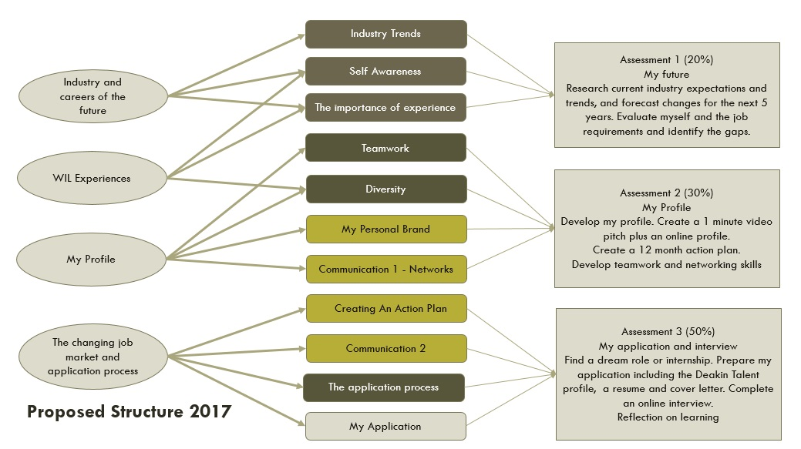
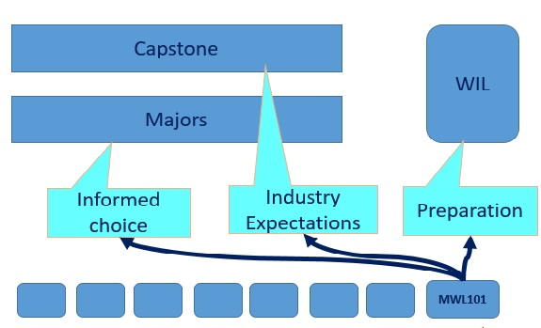
Case study
‘Personal insight’ 1st year core unit in employability
T2 2016: Review to improve pedagogy, inclusivity
2017: Further improvements to marking, assessment, communication
Embedding career readiness assessments in 2nd year, 3rd year
Outcomes (T2, 2016):
  Mean unit mark up 4-6%
  Students more aware of their skills, direction, gaps
2014: Career readiness identified as a key issue, literature review, staff + student interviews
2015: Careers team collaborated to create generic career readiness modules, embedded in 3 units
2016: BComm review: ‘Personal insight’, core 1st year unit
Notes:
Building career readiness of LSES and other equity group students was identified as a key issue in the BComm
Extensive literature on how to build career readiness, 10 staff interviews, 13 student interviews to inform the course-wide design and approaches
2015: Careers team worked with unit chair to embed a generic career readiness module in 3 units
With BComm review, career readiness became the whole focus of a 1st year core unit + revisited in later units
Later in 2016: Further review to improve assessment, group work, experiential & reflective learning strategies, linkages to industry employment, equivalent learning activities for Cloud students, embedding library & academic literacy support
2017: Further improvements to marking guides & marker PD, supporting sessional staff with WIL, practical portfolio assessment, customer service communication strategy, logistical improvements for student interviews
Also in Bcomm, focus on maths literacies for economics, finance, accounting: mastery learning approach with short videos contextualised for each discipline to teach the maths they need, rolled out across first year core units.
Bcomm inclusivity-related enhancements have had great support from the Course Director, ADTL, widespread sharing in the faculty, changes to minimum requirements.

Slide 11
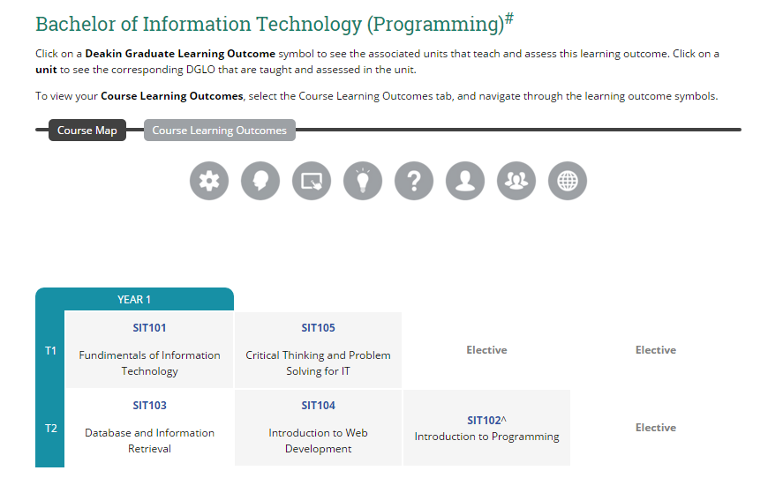
Case study
Inclusive curriculum interventions in Faculty of Science, Engineering & Built Environment
2014: Little interest from faculty, curriculum development done at unit level.
2015: School of IT survey identified student isolation, lack of community.
Developed 3 course sites to provide a hub, with industry employment and news, course map, literacies, etc.
Not a success.
But the project employed a talented learning designer with good understanding of inclusivity, accessibility and IT/Science students, now taken on permanently in the Faculty.
Notes:
In 2014, we wanted to work in Engineering, that had identified needs in inclusive teaching of LSES students – completed 63 UDL unit audits, but nothing happened to improve those units. (Didn’t have support of course director or central T/L group.)
Problem with curriculum work being done at unit level was that unit chairs changed, and unless changes were embedded in assessment activities, they tended to fade
Surveys of students showed isolation: many major streams with a lack of central IT course community
An LLA had had good results with an online course hub in another faculty and suggested one - some in the faculty thought it might provide a shared space for news, job sharing, employability development tips, discussion, surveyed students before building it
Also put up a course map showing where students developed each DGLO.
Evaluation found that course sites added to staff workload and this wasn’t recognised in WAM; updates are needed so students keep coming; students are focused on assessment and individual unit requirements, so the hubs in a different online space had limited use.
The main good outcome was that the ICCB funding enabled the faculty to employ a talented learning designer, who has since come onto permanent staff.

Slide 12
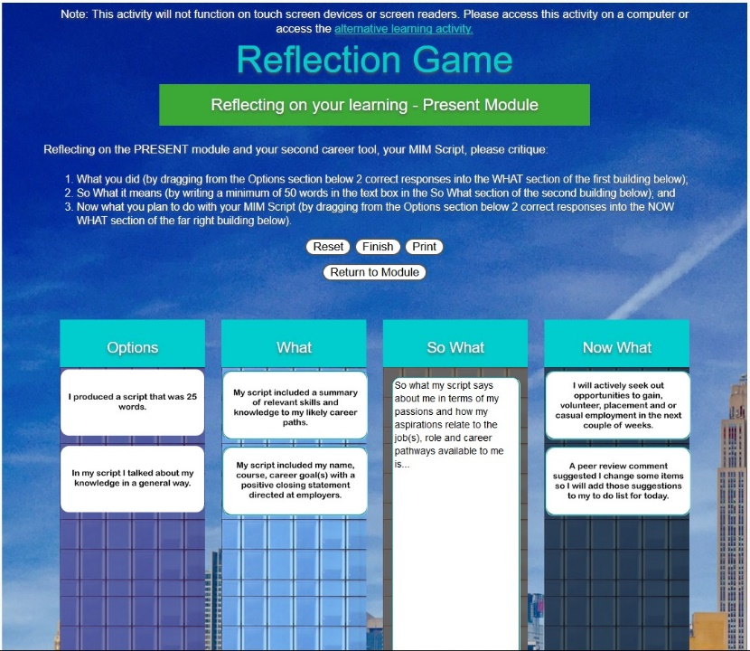
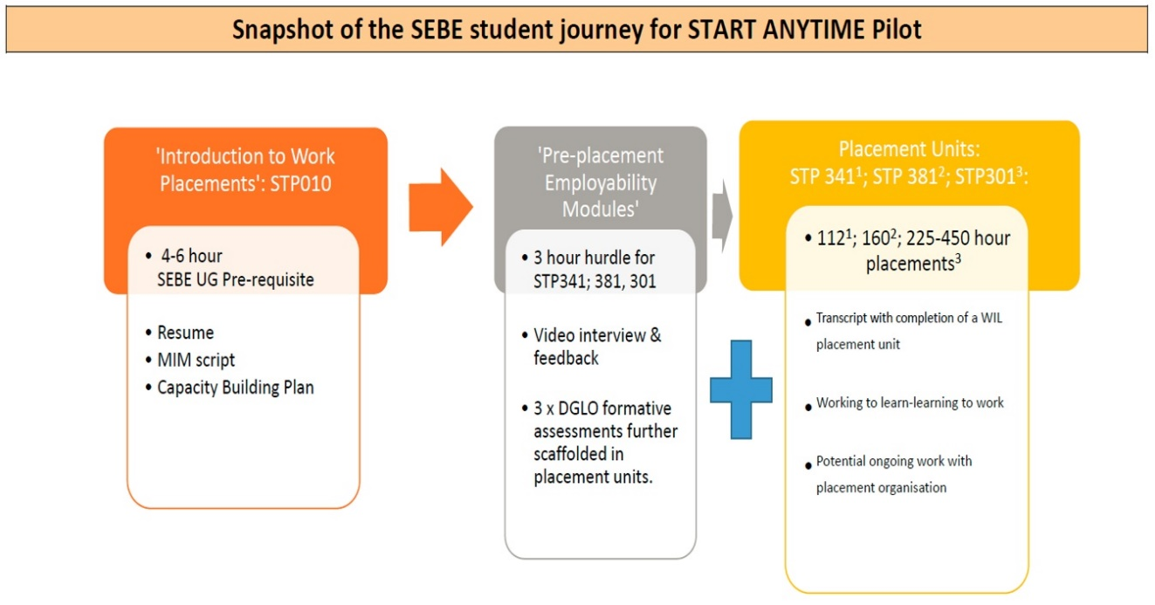
Case study
SEBE case study continued
2016
Champions of course sites project
changed focus to WIL ‘start anytime’
units to support students on placement
0 credit point, mandatory, online unit
with flexible start and end dates, flexible pace.
Online flipped classroom model, using intelligent agents, conditional release, video, graphics
Built on UDL principles,
accessibility, user-testing
Exemplar
2017
Evaluation, publication,
ongoing improvements
Notes:
The Start anytime units are another example of ICCB developing exemplar units or strategies that improve student outcomes, particularly for LSES students, and that have been taken up by others across the university.
Have been a selling point for SEBE’s focus on employability, WIL – timely intervention, the proposal and funding was pulled together within 2 weeks, which ensured the faculty could continue to employ the learning designer on this.
The accessibility requirements for this unit have been helpful in enabling the learning designer to design accessibly across further units.

Slide 13
Lessons learnt from the ground-up approach: enablers
Small projects, agile project management
Neutral central management, empowered partners
Genuine enthusiasm and buy-in from key champions
Integration into major course review processes
Notes:
Provided opportunities to develop new ideas with low risk.
Small size of projects meant managed with agility
Timing is important – need to be able to rise to challenges quickly, when points of need, opportunity identified.
Central management by EDU, neutral player with simple agenda but strong theoretical understanding of complex equity issues, smoothed the process
Partnership model linking ac and prof staff broke down silos, enabled relationships, dev skills. No-one could argue with aims & collab method
Faculties/partners owned their projects, became invested over longer period
Champions emerged with enthusiasm, openness to new practices, genuine interest in student learning – in turn, they achieved good outcomes, publications, recognition.
In comparison, course enhancement program had authority and was able to make massive changes to the curriculum, but were often forced to use a big stick, bottom up approach.
The key question for the university hierarchy is whether this short term funded project called ICCB, based in ED, has the authority and responsibility to lead this change forward – broader commitment and sponsorship of the change is needed.
We have achieved isolated change, deep in pockets but not pervasive. Bottom-up change is only part of the solution.

Slide 14
Lessons learnt from the ground-up approach: barriers
Lack of executive and policy level support
Working from the periphery and through influence
Reliance on committed individuals
Limitations of short-time funding
Evaluations of widening participation initiatives, esp. of embedded curriculum-focused ones
Notes:
Lack of support at executive and policy level meant diffusion was patchy; hardly transformative change – more a ‘diffusion of innovations’ (Rogers 2003) model; Eckel & Kezar (2003): isolated change – deep but not pervasive
Equity & Diversity Unit, working on the periphery, was unable to insist on completion, evaluation, etc. Main focus had to be on building relationships and working through influence, persuasion, strength based, good practice – it all rests on good faith!
Reliance on individuals with high energy, enthusiasm and (unacknowledged) time. Changing unit chairs meant continuity was sometimes lost.
Short-term funding limited scope of projects, strong project design
LSES student outcomes are difficult to target and track, leading to difficulties justifying projects

Slide 15
Transformational change?
Collaborative leadership
Flexible vision
Faculty and staff development
Visible action
X Senior administrative support
No transformational but isolated change: deep but not pervasive (Eckel & Kezar, 2003)

Slide 16
Questions & Comments
Contact us:
Dr Mary Dracup, Equity & Diversity Unit, Deakin University: mary.dracup@deakin.edu.au
Dr Nadine Zacharias, Faculty of Arts & Education, Deakin University: nadine.zacharias@deakin.edu.au
Robyn Everist, Equity & Diversity Unit, Deakin University: robyneverist@deakin.edu.au

Slide 17
references
Crozier, G., Reay, D., Clayton, J., Colliander, L. & Grinstead, J. (2008). Different strokes for different folks: diverse student in diverse institutions – experiences of higher education. Research Papers in Education, 23(2), pp. 167-177.
Devlin, M., James, R. & Grigg, G. (2008). Studying and working: a national study of student finances and student engagement. Tertiary Education and Management, 14(2), pp. 111-122.
Eckel, P.D. & Kezar, A. (2003). Taking the reins: institutional transformation in higher education.
Westport, CT: Praeger.
Engstrom, C. & Tinto, V. (2008). Access without support is not opportunity. Change, January/February 2008, pp. 46-50.
James, R., Baldwin, G., Coates, H., Krause, K.-L. & McInnes, C. (2004). Analysis of equity groups in Higher Education 1991-2002. Melbourne: Centre for the Study of Higher Education, the University of Melbourne.
Kift, S. (2009). Articulating a transition pedagogy to scaffold and to enhance the first year student learning experience in Australian higher education – Final report for ALTC Senior Fellowship Program. Brisbane, QUT.
Kift, S. & Nelson, K. (2005). Beyond curriculum reform: embedding the transition experience. Paper presented at the HERDSA Conference 2005: Higher Education in a changing world, Sydney.
Krause, K-L., Hartley, R., James, R., & McInnis, C. (2005). The First Year Experience in Australian Universities: Findings from a Decade of National Studies. Canberra: Australian Department of Education, Science and Training.

