Slide 1
Time for a boldleap
BRILLIANT ONLINE LEARNING DESIGN + LEADERSHIP IN ACTIVE LEARNING PROGRAM
|Professor Judy Currey |Dr Ian Story |Ms Berni Murphy |Ms Michele McGrath |Dr Elizabeth Oldland

Slide 2
OPPORTUNITIES
Preventing avoidable failure
Addressing student retention and success.
Evidence
Active and collaborative learning andragogy is solid.
Pockets of Excellence
Deakin in active and collaborative learning.
Deakin enablers
Cloud learning design prior to seminars, campus classrooms design and policy.
Deakin University CRICOS Provider Code: 00113B
BRILLIANT ONLINE LEARNING DESIGN + LEADERSHIP IN ACTIVE LEARNING PROGRAM

Slide 3
THE LEARNING PARADIGM
Traditional
Passive
Lecture
Study
Pre-work
01
02
03
Assessment
Before
During
After
Active Collaborative
Active
Learning
Pre-work
01
02
Homework
03
Assessment
Before
During
After
Deakin University CRICOS Provider Code: 00113B
BRILLIANT ONLINE LEARNING DESIGN + LEADERSHIP IN ACTIVE LEARNING PROGRAM
Notes:
Another way to say this is that we are changing the learning paradigm.

Slide 4
BRILLIANT ONLINE LEARNING DESIGN + LEADERSHIP IN ACTIVE LEARNING PROGRAM
Active
Passive
Responsive
Deakin University CRICOS Provider Code: 00113B
BRILLIANT ONLINE LEARNING DESIGN + LEADERSHIP IN ACTIVE LEARNING PROGRAM

Slide 5
BRILLIANT ONLINE LEARNING DESIGN + LEADERSHIP IN ACTIVE LEARNING PROGRAM
Comprehensive program to operationalize active and collaborative learning at scale for course and unit teams.
All Deakin students receive active and collaborative learning experiences
Staff learn skills to facilitate active and collaborative learning experiences to learning outcomes
Students acquire knowledge online pre-class - BOLD
Deakin University CRICOS Provider Code: 00113B
BRILLIANT ONLINE LEARNING DESIGN + LEADERSHIP IN ACTIVE LEARNING PROGRAM

Slide 6
CORE PRINCIPLES
Assess
Backward Design
AAA
Collaborative Class
Acquire
Visible Learning
Learner Feedback
Human Skills
3PR Strategy
Apply
Deakin University CRICOS Provider Code: 00113B
BRILLIANT ONLINE LEARNING DESIGN + LEADERSHIP IN ACTIVE LEARNING PROGRAM

Slide 7
TEACHING TEAM: 3PR
Purpose
Student-centred learning
Plan
3PR
Deliberate learning design
Perform
Facilitate to learning outcomes
Reflect
Critical reflection on PPP
Deakin University CRICOS Provider Code: 00113B
BRILLIANT ONLINE LEARNING DESIGN + LEADERSHIP IN ACTIVE LEARNING PROGRAM

Slide 8
LEAP: LEADERSHIP IN ACTIVE LEARNING PROGRAM
ESSENTIALS
INTERMEDIATE
ADVANCED
Deakin University CRICOS Provider Code: 00113B
BRILLIANT ONLINE LEARNING DESIGN + LEADERSHIP IN ACTIVE LEARNING PROGRAM

Slide 9
”
STAFF COMMENTS
BOLD LEAP workshops were an absolute revelation. The chance to be involved with others, my peers, my colleagues in a facilitated environment. We got to actually learn by doing and be supported while we discussed, examined and investigated all of the conditions that we experience and see within the classroom
”
The idea of creating an Active Learning environment that focuses on students’ learning, instead of students being taught, is really, really exciting
”
”
there is a sense of belonging and connectedness…
no one is left behind, no one has the opportunity to be invisible…
because they’re working as part of a team
My key takeaway for the BOLD LEAP workshop is that students are at the centre of learning
Deakin University CRICOS Provider Code: 00113B
BRILLIANT ONLINE LEARNING DESIGN + LEADERSHIP IN ACTIVE LEARNING PROGRAM

Slide 10
Progressive Roll Out
Pilot program completed in 2019
Adoption: FBL-B Comm core units; SEBE-Math
Implementation: MWL101, MMK101, SIT192
Reach: 2020: GradDipFinPlan, MIS171; MAE101
Effectiveness: anecdotal positive, evaluation planned
Deakin University CRICOS Provider Code: 00113B
BRILLIANT ONLINE LEARNING DESIGN + LEADERSHIP IN ACTIVE LEARNING PROGRAM

Slide 11
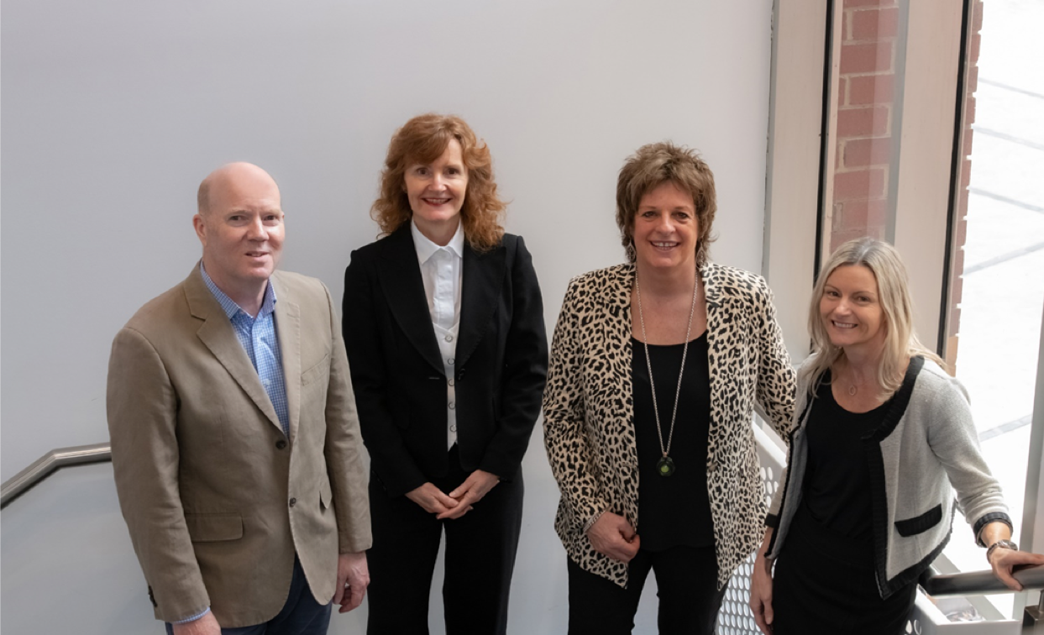
COMMENTS AND QUESTIONS WELCOME
Deakin University CRICOS Provider Code: 00113B
BRILLIANT ONLINE LEARNING DESIGN + LEADERSHIP IN ACTIVE LEARNING PROGRAM

