Slide 1
Building relationships online: Online and on campus research supervisor perspectives
Dr Ruth Tatnell
13 Nov, 2019

Slide 2
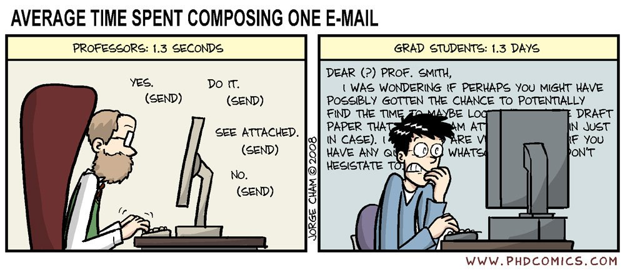
Why are relationships so important anyway?

Slide 3
Overview of the project
Part one: Supervisors
Interview 10 online and 10 on campus 4th year supervisors about their experiences
Part two: Students
Interview 10 online and 10 on campus 4th year students about their experiences
Assess differences between experiences of supervisors and students, online and on campus

Slide 4
Part one: Supervisors
Who were the participants?
 | Online (N = 10) | On Campus (N = 6)
Age | 36.8 | 36.5
% female | 70% | 33.3%
Time in role | 1.2 yrs ( <6 mths – 2yrs) | 2.8 yrs (1-4)
Fraction (FT, PT C) | 50% FT, 20% PT, 30%C | 100% FT
Total 4th year projects | 14.5 (7-33) | 15.8 (4-42)
Completed 4th year projects | 3.4 (0-8) | 13.7 (2-42)
Contact with students | 1 x 25-40 min meeting one-on one p/w + ‘lab group’ 1 x 60 mins fortnightly (optional); emails 1-5 (varies) p/w – some happy, others would like more time/more flexibility | 1 x 30-60 min meeting one-on one + one 1-2 hour lab group p/w; emails 1-4 (varies) p/w – happy with this

Slide 5
Supervisor roles
I asked supervisors to rank 11 accepted supervisor roles in order of importance (1-11)

Slide 6
Supervisor perspectives: Key themes (from notes made during interviews)
Topics: | Themes raised by online supervisors | Themes raised by on campus supervisors
What makes a good supervision relationship? | Rapport, open communication, setting expectations early, mutual respect, empathy, warmth, clear and prompt feedback | Open communication, rapport, setting expectations early (together), support, clear and prompt feedback, encouraging independence - “student and supervisor manage each other”
What attributes make a good supervisor? | Let go of control, knowledge, expertise, communication skills, organisation, flexibility | Availability (time, approachable), being mindful and respectful of students work, needs, goals etc, expertise, competence
What attributes make a good student? | Open minded, resilient, motivated, good time management, independent | Open minded, resilient, good time management, curious, conscientious
Key benefits/challenges of OL vs OC | Lack community, networking, peer opportunities, lack of quality (research and teaching), flexible, fast | Unsure of model, lack of community, no access to tech; flexible (no ‘bump in’)

Slide 7
Next steps…..
1. Recruit 10 online 4th year students and 10 on campus students (near the end of their thesis) for interview.
2. Rating activity
3. Interview
Part 2: Students

Slide 8
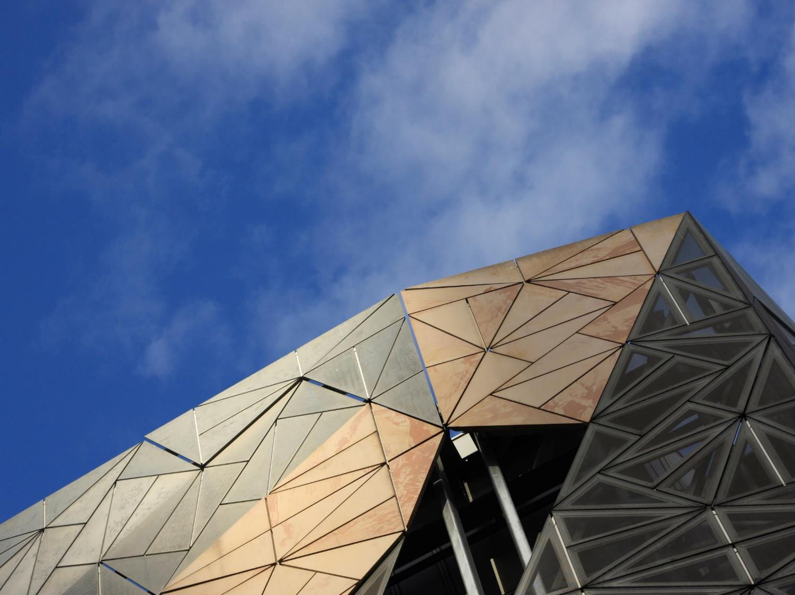
Questions/comments?
Ruth.Tatnell@deakin.edu.au

