Slide 1
Implementing a new version of the CloudDeakin homepage
Jo Smissen & Kate Pesa
SEBE CloudDeakin Support

Slide 2
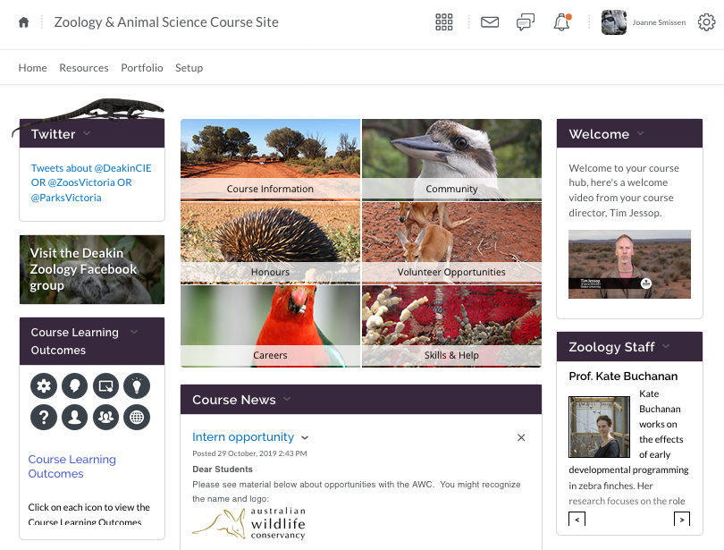
SEBE Course Site Homepage

Slide 3
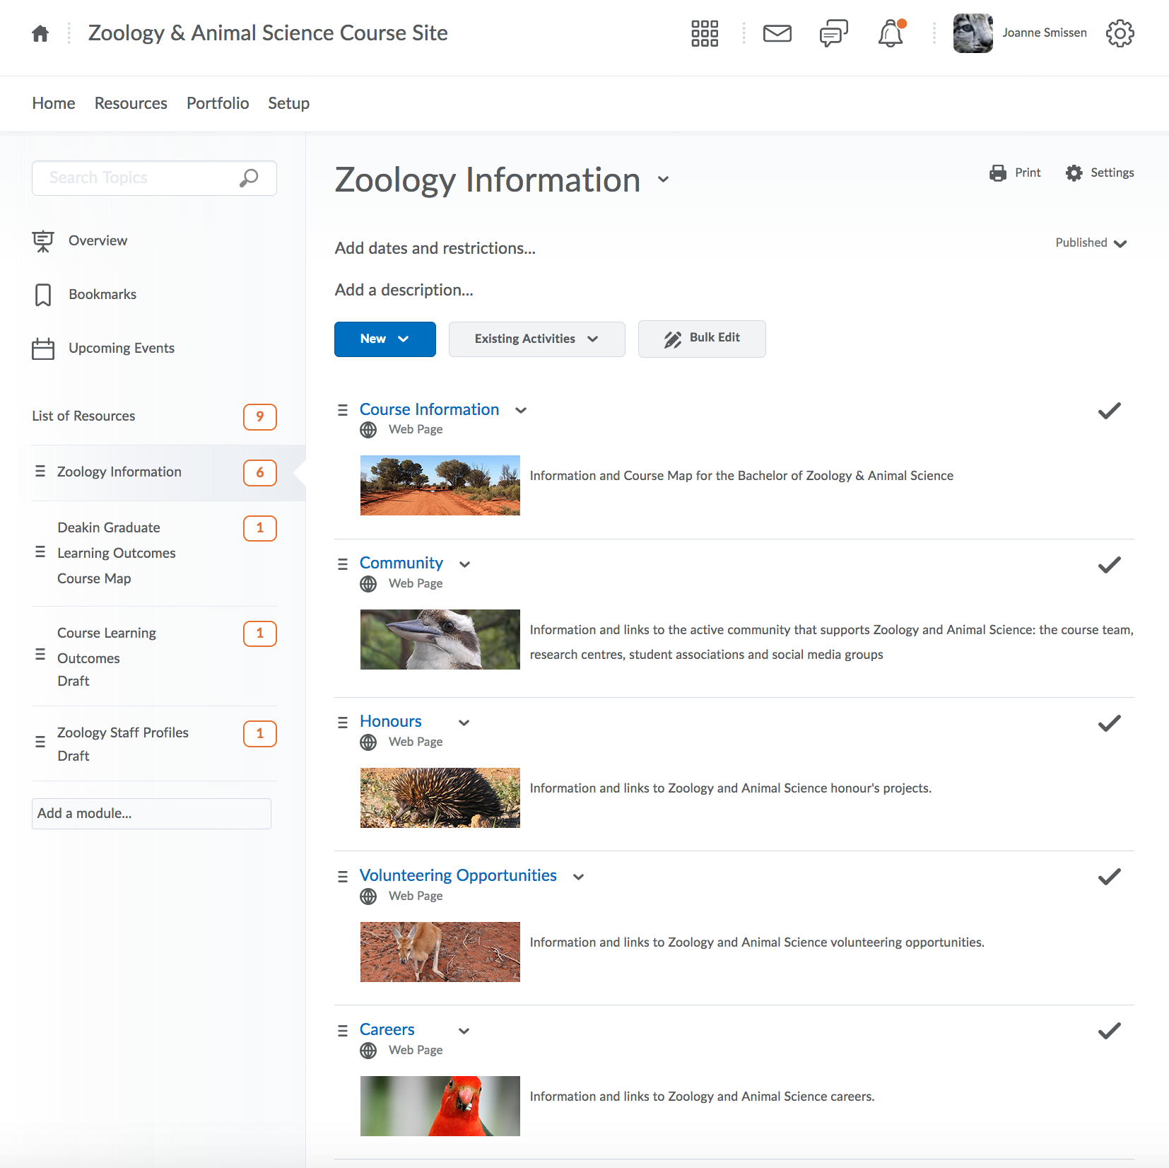
SEBE Course Site Resources

Slide 4
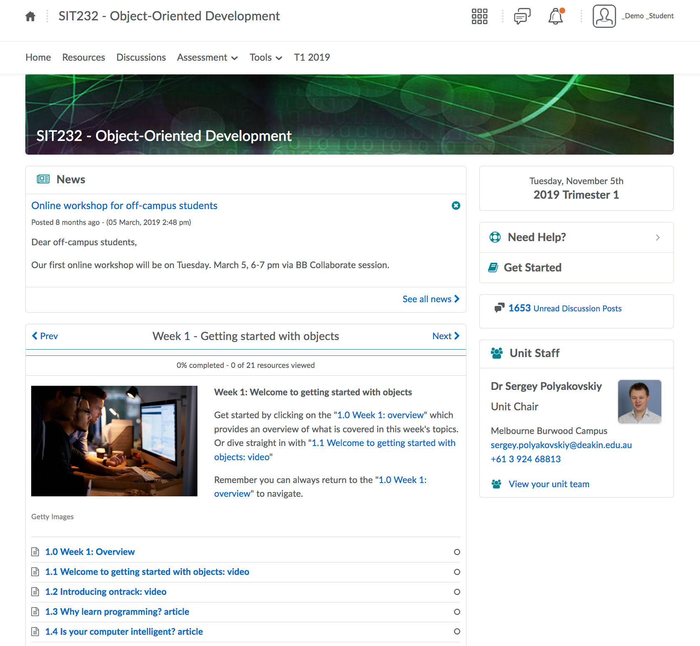
SEBE Unit site + Resources widget (Weekly model Week #1) Homepage

Slide 5
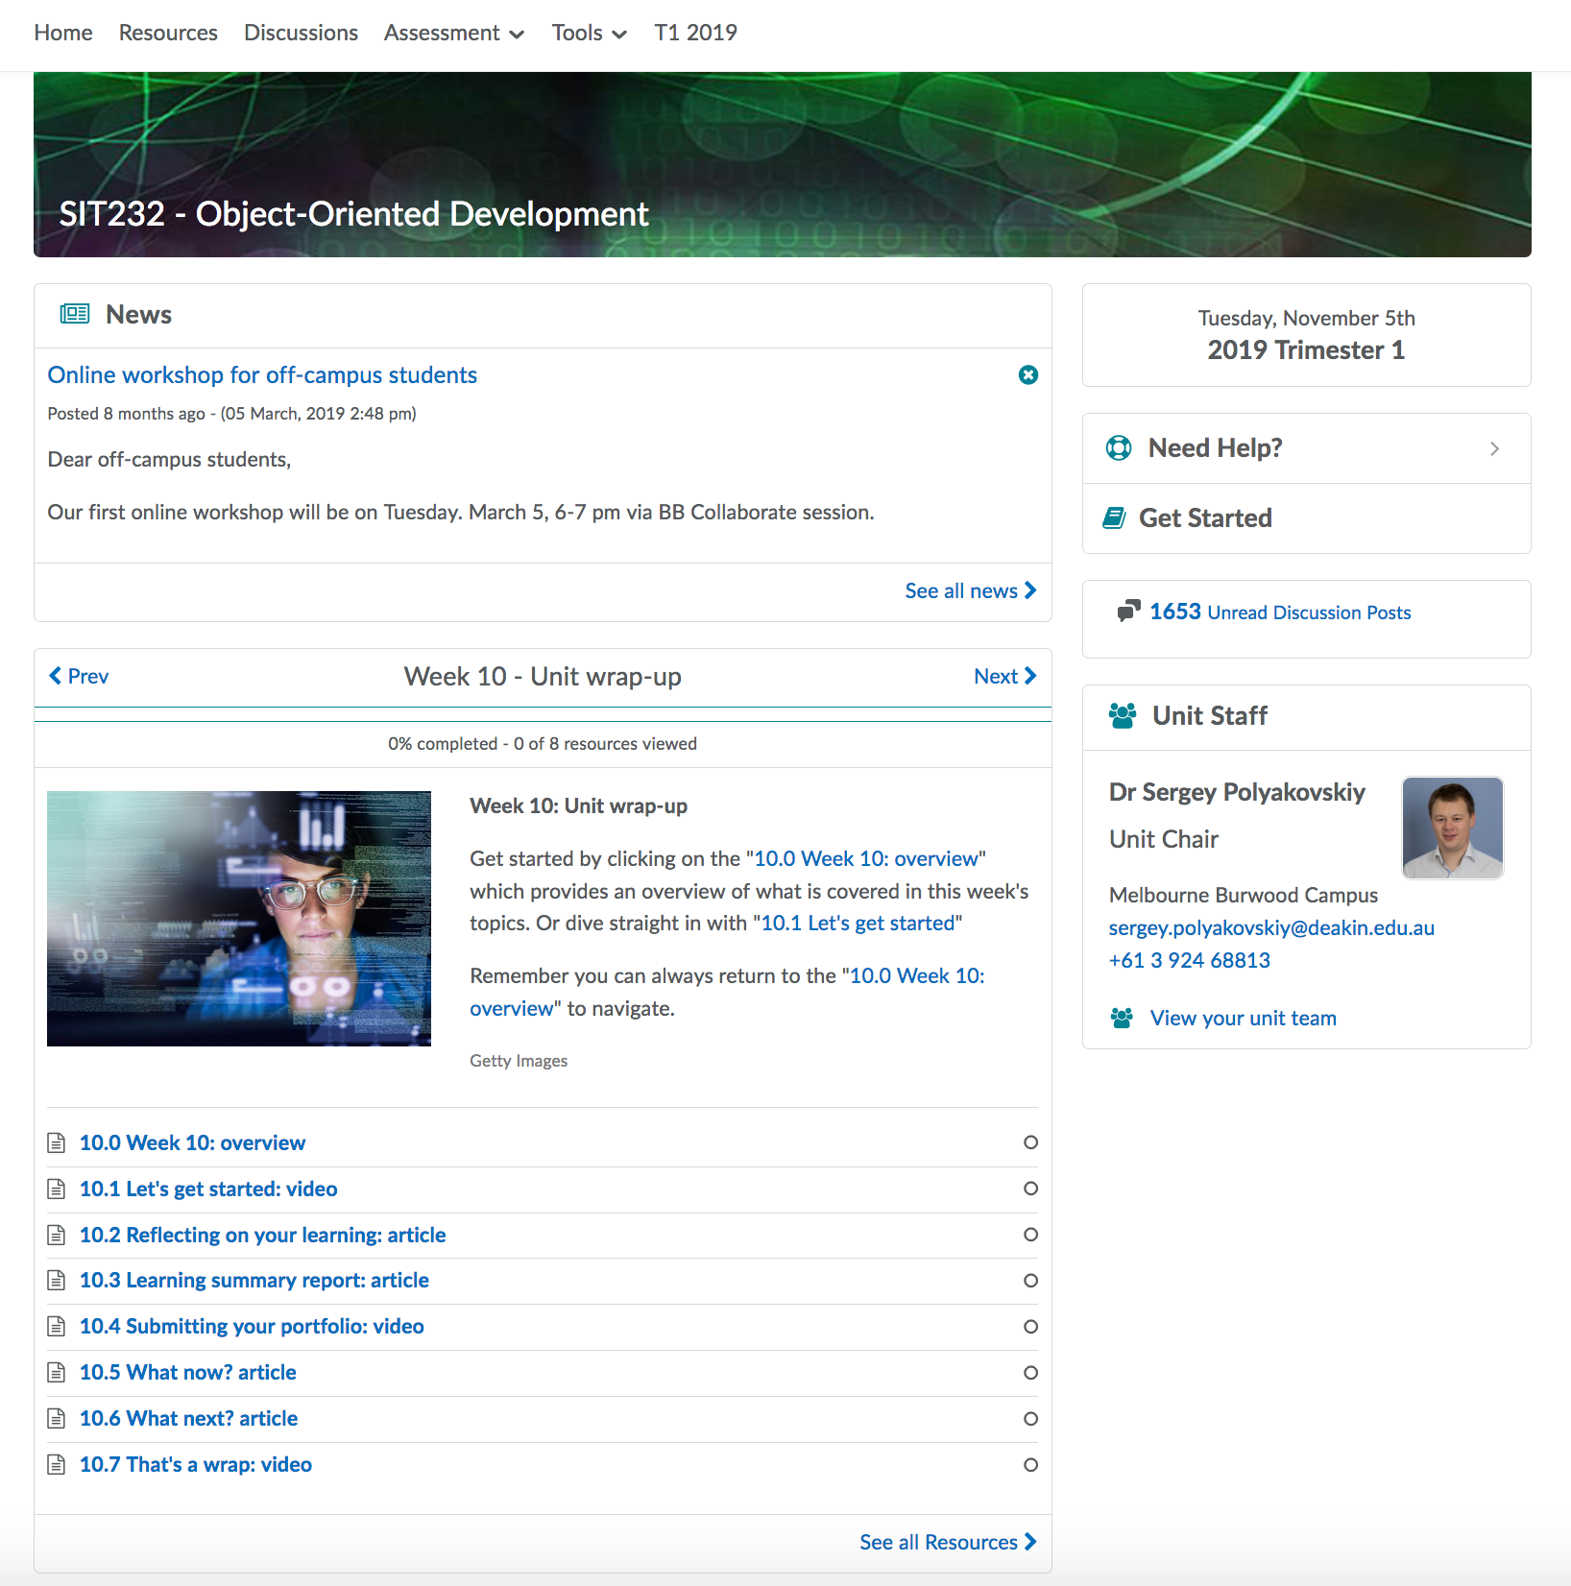
SEBE Unit site + Resources widget (Weekly model Week #10) Homepage

Slide 6
SEBE Unit site + Resources widget (Weekly model Week #10) Homepage

Slide 7
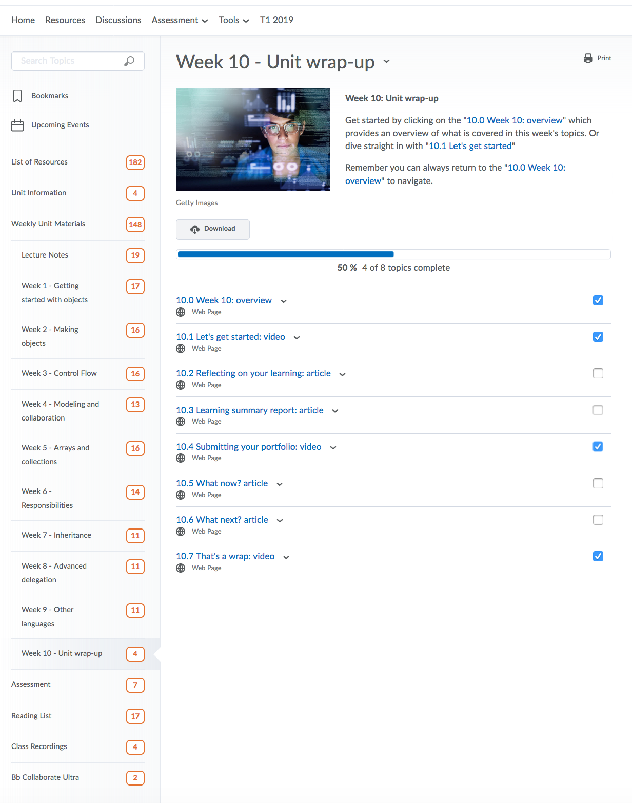
SEBE Unit site + Resources widget (Weekly model Week #10) Resources

Slide 8
SEBE Unit site + Resources widget (Weekly model Week #10) Resources

Slide 9
SEBE Unit site + Resources widget (Weekly model Week #10) Homepage

Slide 10
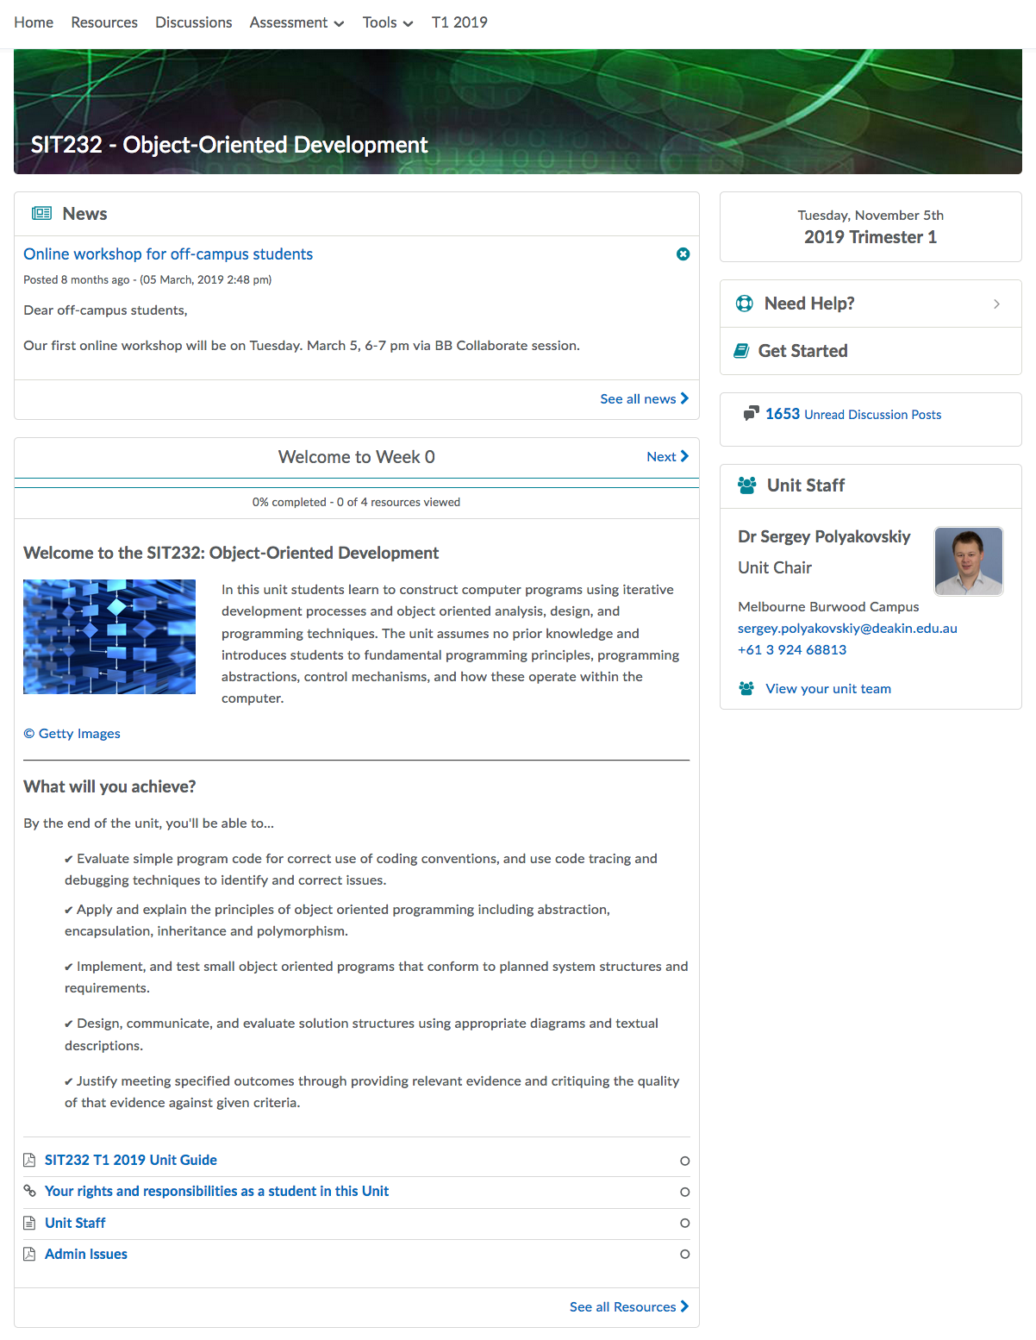
SEBE Unit site + Resources widget (Weekly model Week #0) Homepage

Slide 11
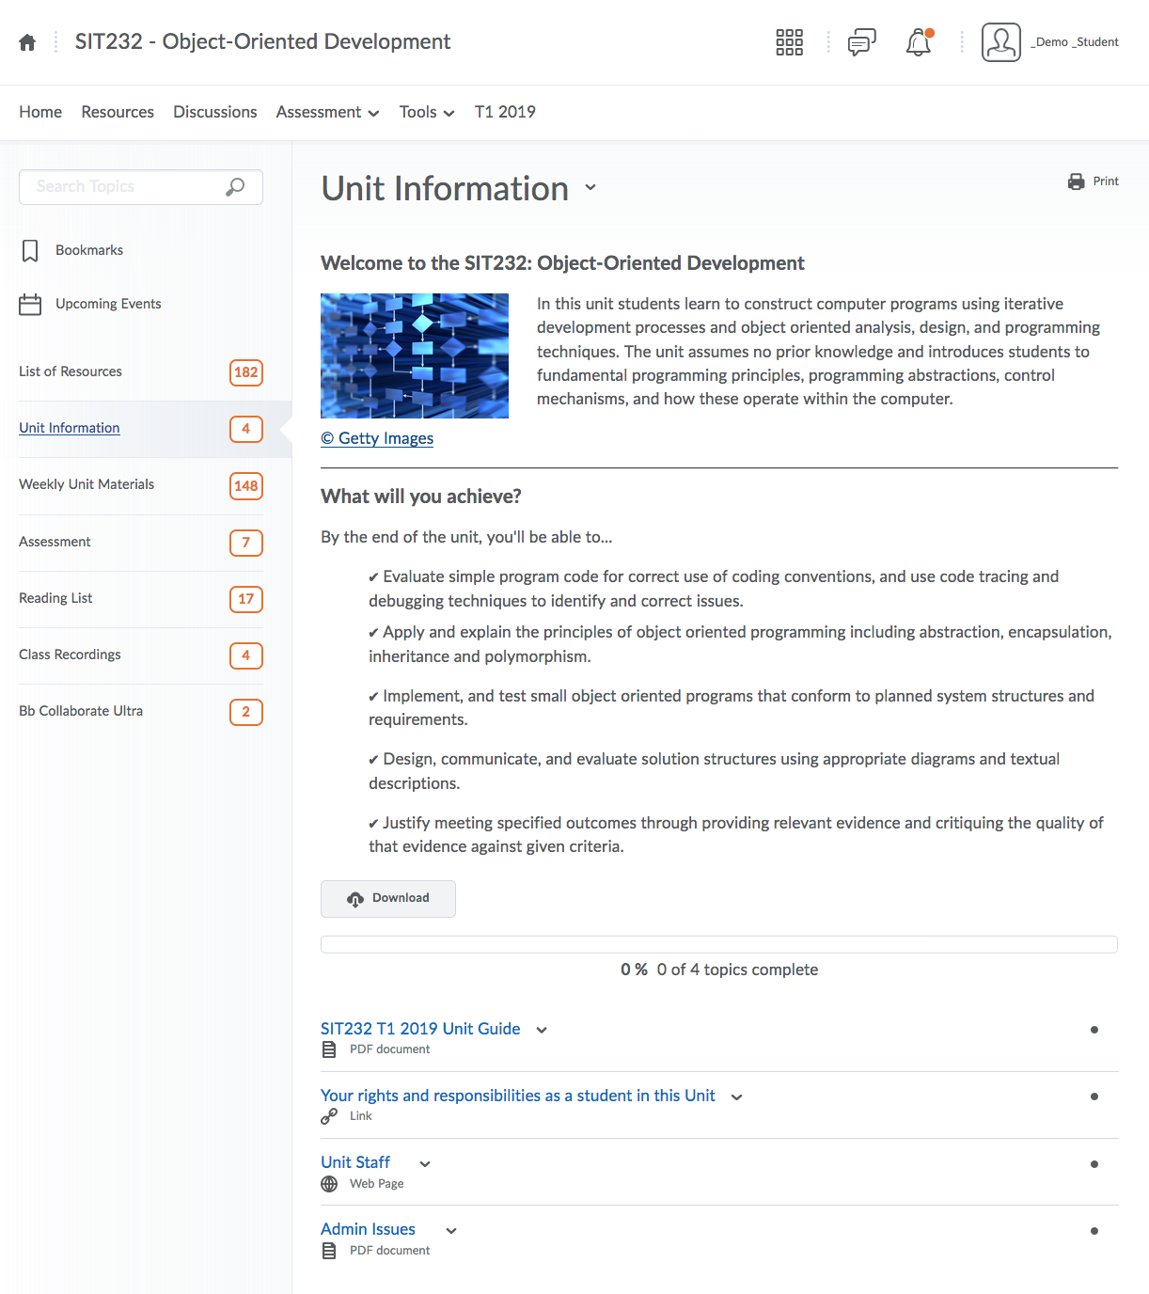
SEBE Unit site + Resources widget (Weekly model Week #0) Resources

Slide 12
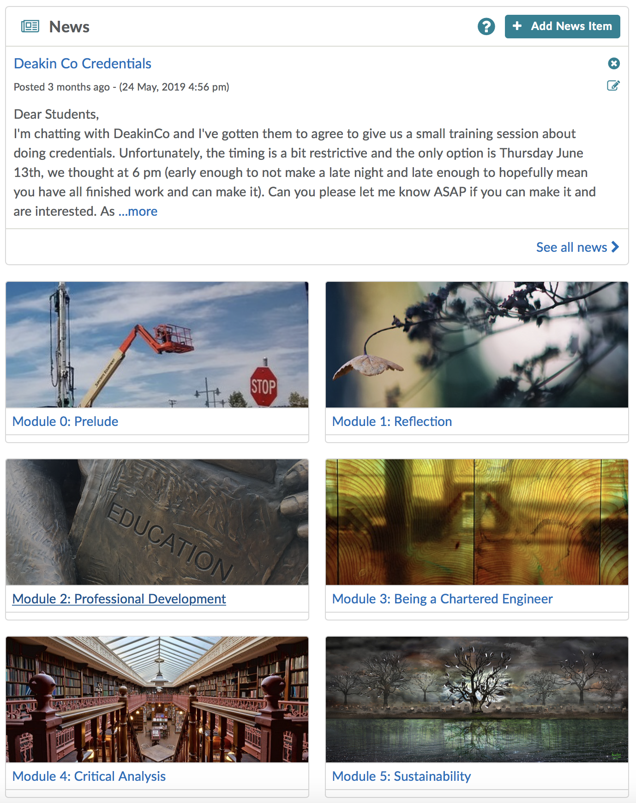
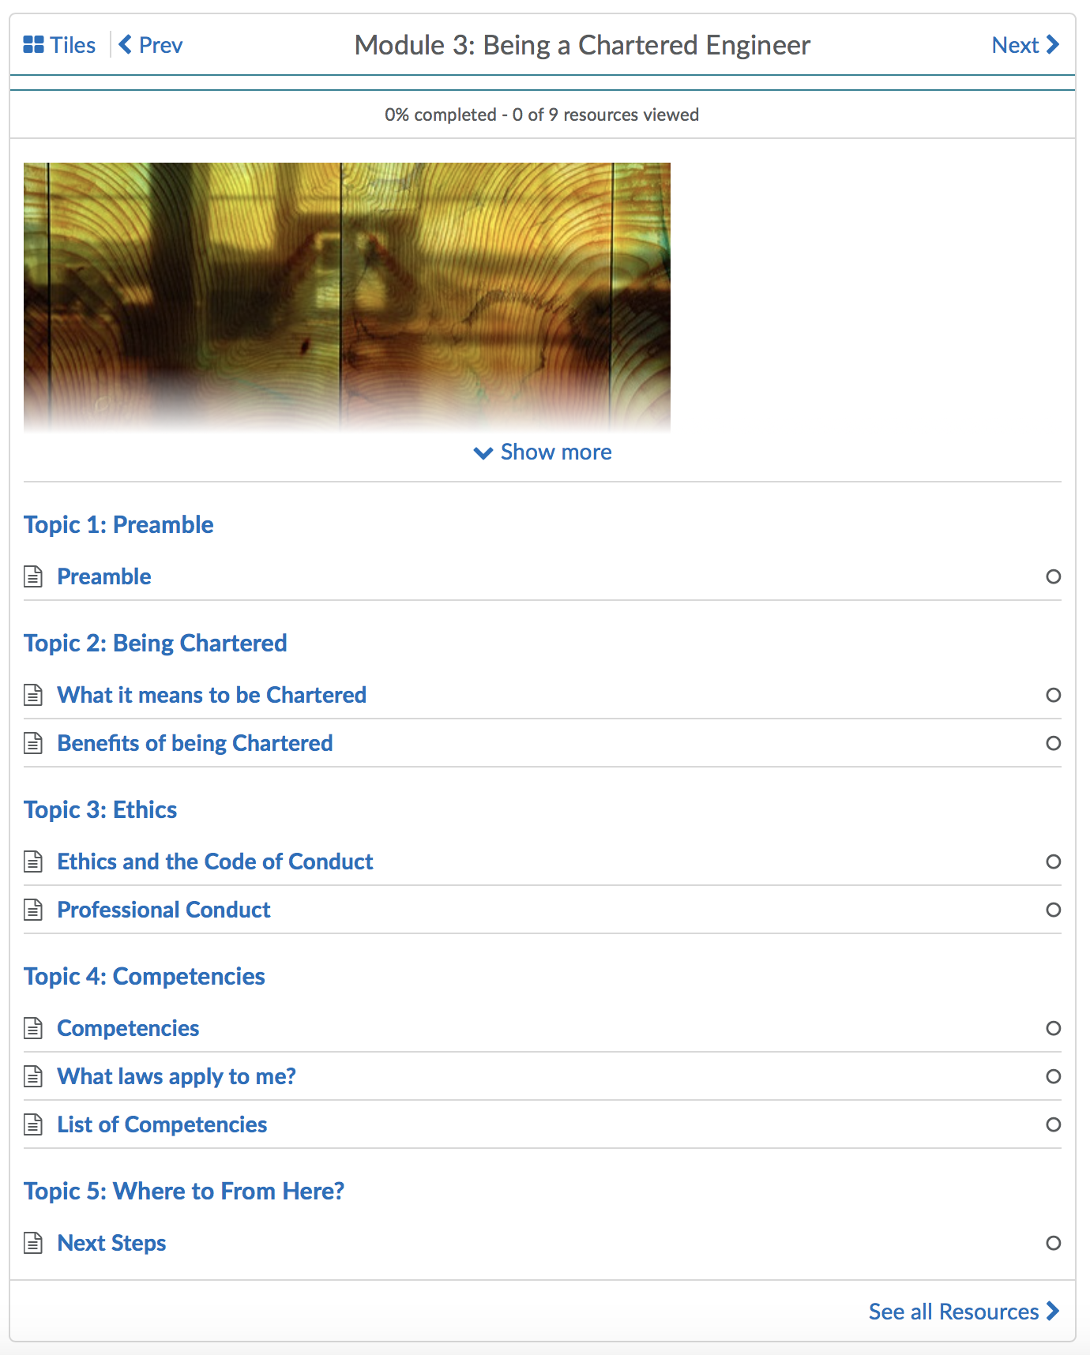
SEBE Unit site + Resources widget (Modules – no specific order)
Homepage

Slide 13
SEBE Homepage student survey
Survey ran mid-trimester in T1 & T2 2019
Number of units: 30 (T1) + 75 (T2)
Type of Resources widget:
26 weekly / 4 module based (T1)
68 weekly / 7 module based (T2)
Total student responses: 396 (T1) + 288 (T2)

Slide 14
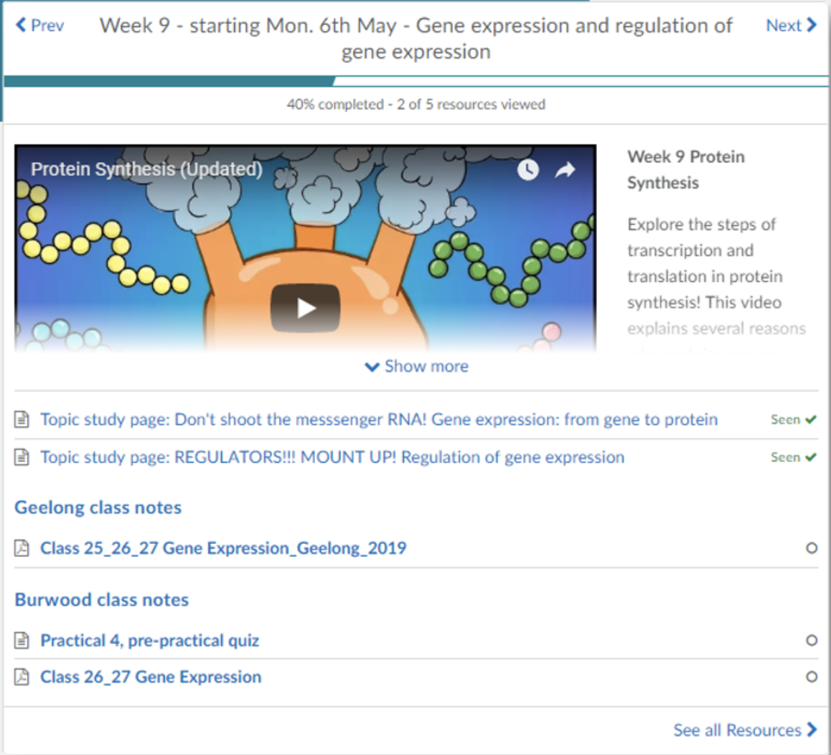
Resources widget: Features

Slide 15
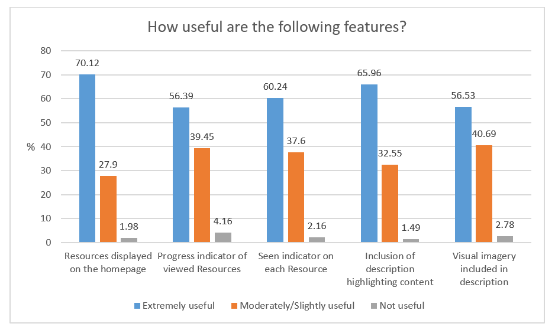
Resources widget: Features (student responses)

Slide 16
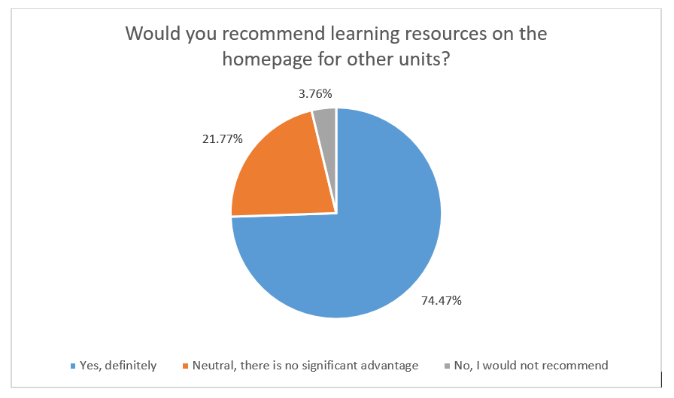
Resources widget: Advantages (student responses)
Can see what is required each week
Helps to keep track of studies
Use of sub-modules make it clear to view
Less clicks to view Resources

Slide 17
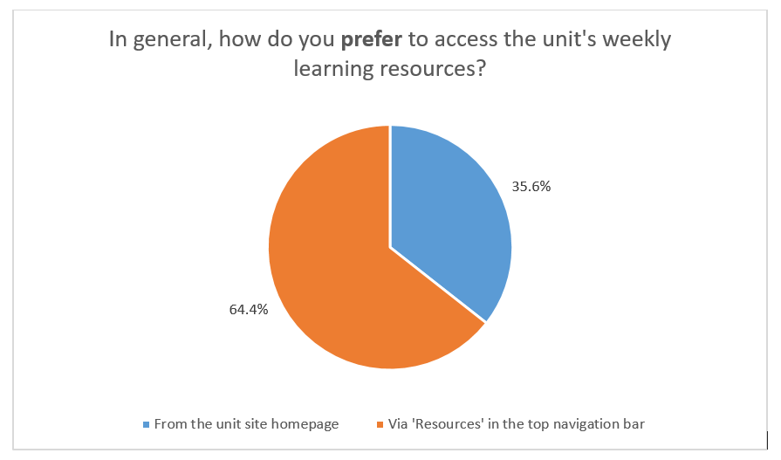
Resources: Access preference (student responses)
Resources get lost under News - needs to be more prominent on the Homepage
Habit – quick and easy to navigate from top bar
Preference for seeing a complete overview of Resources
Prefer to download all resources in one go rather than referring back weekly

Slide 18
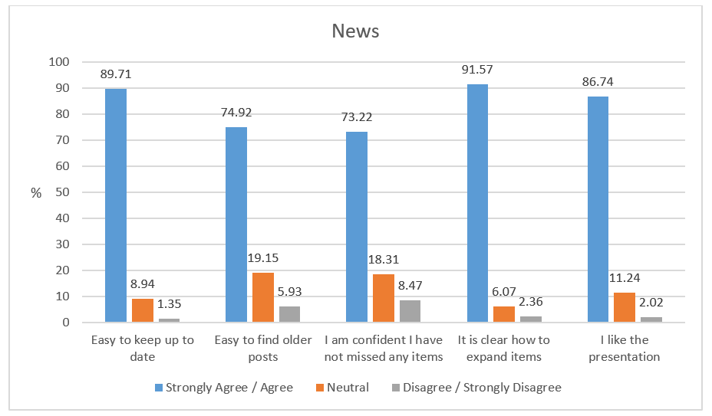
News: Reduced size (student responses)

Slide 19
Jo Smissen
Team Leader
joanne.smissen@deakin.edu.au
Kate Pesa
Technical Officer
kate.pesa@deakin.edu.au
Questions?

