Slide 1
Advancing Science and Engineering through Laboratory Learning (ASELL) for Schools
Kieran F Lim 林百君
Deakin University

Slide 2
Acknowledgement of Country
Our workshop is being held on the traditional lands of the peoples of the Kulin nations, and I wish to acknowledge them as Traditional Owners.
I would also like to pay my respects to their Elders, past and present, and the Elders from other communities who may be here today.
Notes:
? Bunurong people of the Kulin nations ?

Slide 3
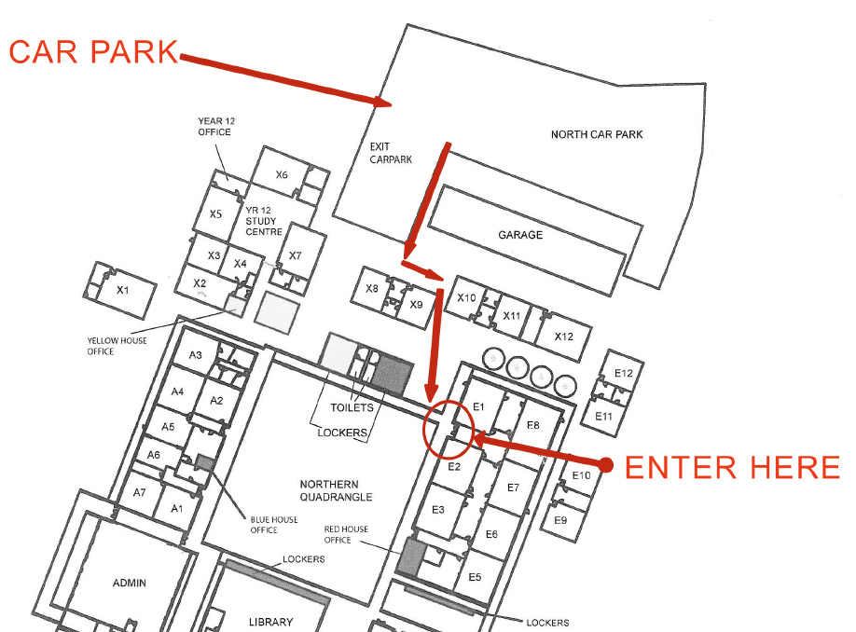
Mooroolbark College

Slide 4
Mooroolbark College
Science
Toilets

Slide 5
Organisers
Amanda Peters
Rebecca Blowfield
Debra Curciev
Kieran Lim
Peta White
John Long
Ian Bentley

Slide 6
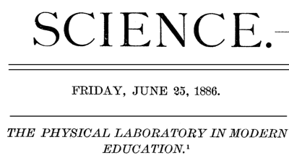
The problem with modern education
H.A. Rowland, “The Physical Laboratory in Modern Education”, Science
“The object of education is not only to produce a [student] who knows, but one who does; who makes [their] mark in the struggle of life, and succeeds well in all [s/he] undertakes; who can solve the problems of nature and humanity as they arise; and who, when [they] know [they] are right can convince the world of that fact…
There is no doubt in my mind that this is the point in which much of our modern education fails. Why is it? I answer that memory alone is trained, and that reason and judgment are used merely to refer matters to some authority who is considered final….
To produce [students] of action, they must be trained in action…
If they study the sciences, they must enter the laboratory, …”
What are some buzz words in (science) education?

Slide 7
The problem with modern education
H.A. Rowland, “The Physical Laboratory in Modern Education”, Science
“The object of education is not only to produce a [student] who knows, but one who does; who makes [their] mark in the struggle of life, and succeeds well in all [s/he] undertakes; who can solve the problems of nature and humanity as they arise; and who, when [they] know [they] are right can convince the world of that fact…
There is no doubt in my mind that this is the point in which much of our modern education fails. Why is it? I answer that memory alone is trained, and that reason and judgment are used merely to refer matters to some authority who is considered final….
To produce [students] of action, they must be trained in action…
If they study the sciences, they must enter the laboratory, …”
Active
learning
Problem
solving
Communication
Skills
Not rote
Learning
Wikipedia??

Slide 8
ASELL for Schools
Focus on
Experiments/practical work
Investigations
Science Inquiry Skills
Aim
… engaging students with stimulating investigations inside and outside the classroom
Look at
Ways and tools for engaging
Years 7 to 10

Slide 9
What we will do today
In your booklet

Slide 10
What you will do in the Lab Activities
Laboratory Learning Activities (LLAs)
Often designed to be a double period or more
Workshop Activities
Often shortened to an hour or less
Not assessed
Need to get “taste” of activity
Judge:
Is it useful?
Which parts are good?
Which parts need improvement?

Slide 11
How we will improve practicals
Do the practical (allocated groups)
Discuss the practical
Good?
Needs improvement?
How to systematically improve the practical?
Feedback and comments (individual)
Need your permission to share feedback and comments

Slide 12
Key issues/questions
Q1: Data interpretation skills
Q2: Developing laboratory skills
Q3: Interest
Q4: Clear assessment
Q5: Clear learning objectives
Q6: Increased understanding of science
Q7: Sufficient/appropriate background
Q8: Effective supervision and guidance
Q9: Procedure clearly explained
Q10: Relevance to science studies
Q11: Developing teamwork
Q12: Responsibility for own learning
Correlation:
Overall
learning
Experience?

Slide 13
Key issues/questions
✔️
✔️
✔️
✔️
✔️
✔️
✔️

